Slide 1













IDeA-CTR N3C Investigator Engagement Event:
Jumpstarting Access to Clinical Data
for COVID-19 Research
Thursday, February 17, 2022 | 2:00-5:00 PM EST
CTR N3C Studies
What is the Best Therapy for COVID-19?
J. Zachary Porterfield, MD, PhD
Assistant Professor of Microbiology, Immunology & Molecular Genetics & Infectious Diseases
University of Kentucky
Bradley S. Price, PhD
Assistant Professor of Business Data Analytics
West Virginia University
U54GM104942-06S4

Slide 2
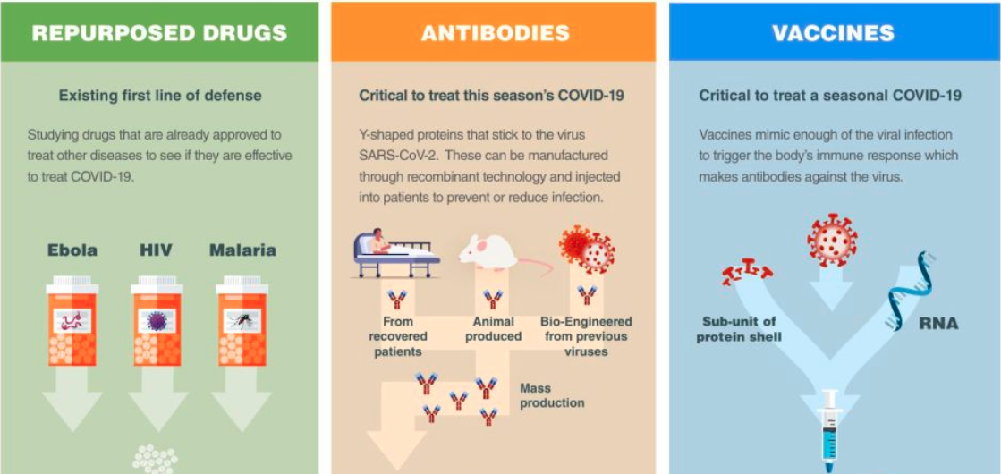
General Treatment Categories
Multiple different treatment goals:
  Prevention of severe illness
  Recovery
  Prevention of transmission
https://synbiobeta.com/covid19/

Slide 3
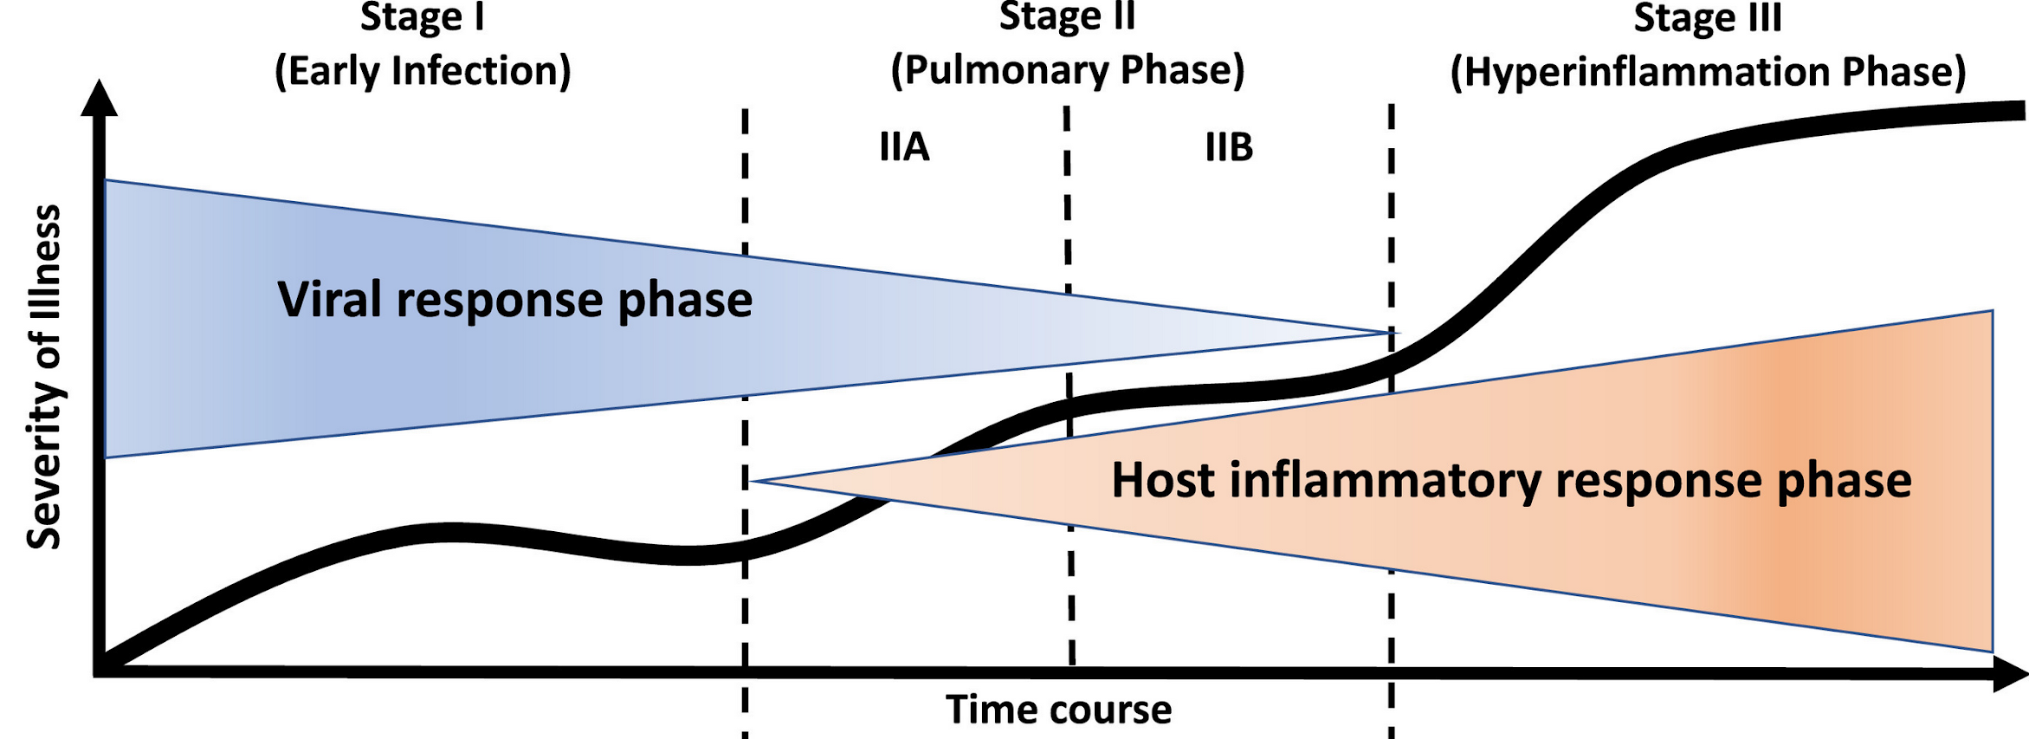
Spectrum of Illness
Distinct phases of disease may require different treatment approaches
Antivirals for Viral phase vs Anti-inflammatories for Inflammatory phase

Slide 4
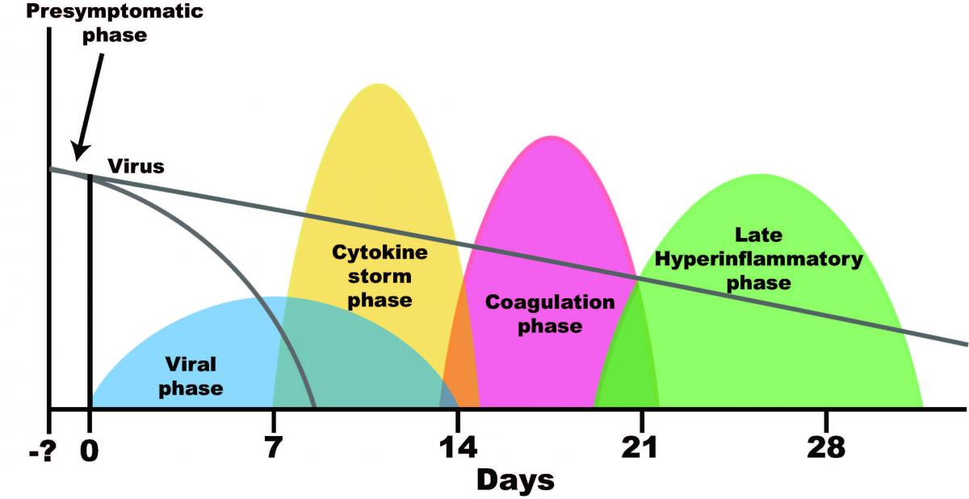
Spectrum of Illness
Other Phases:
Hypercoaguable
Late inflammatory
Post-acute Sequelae of COVID-19

Slide 5

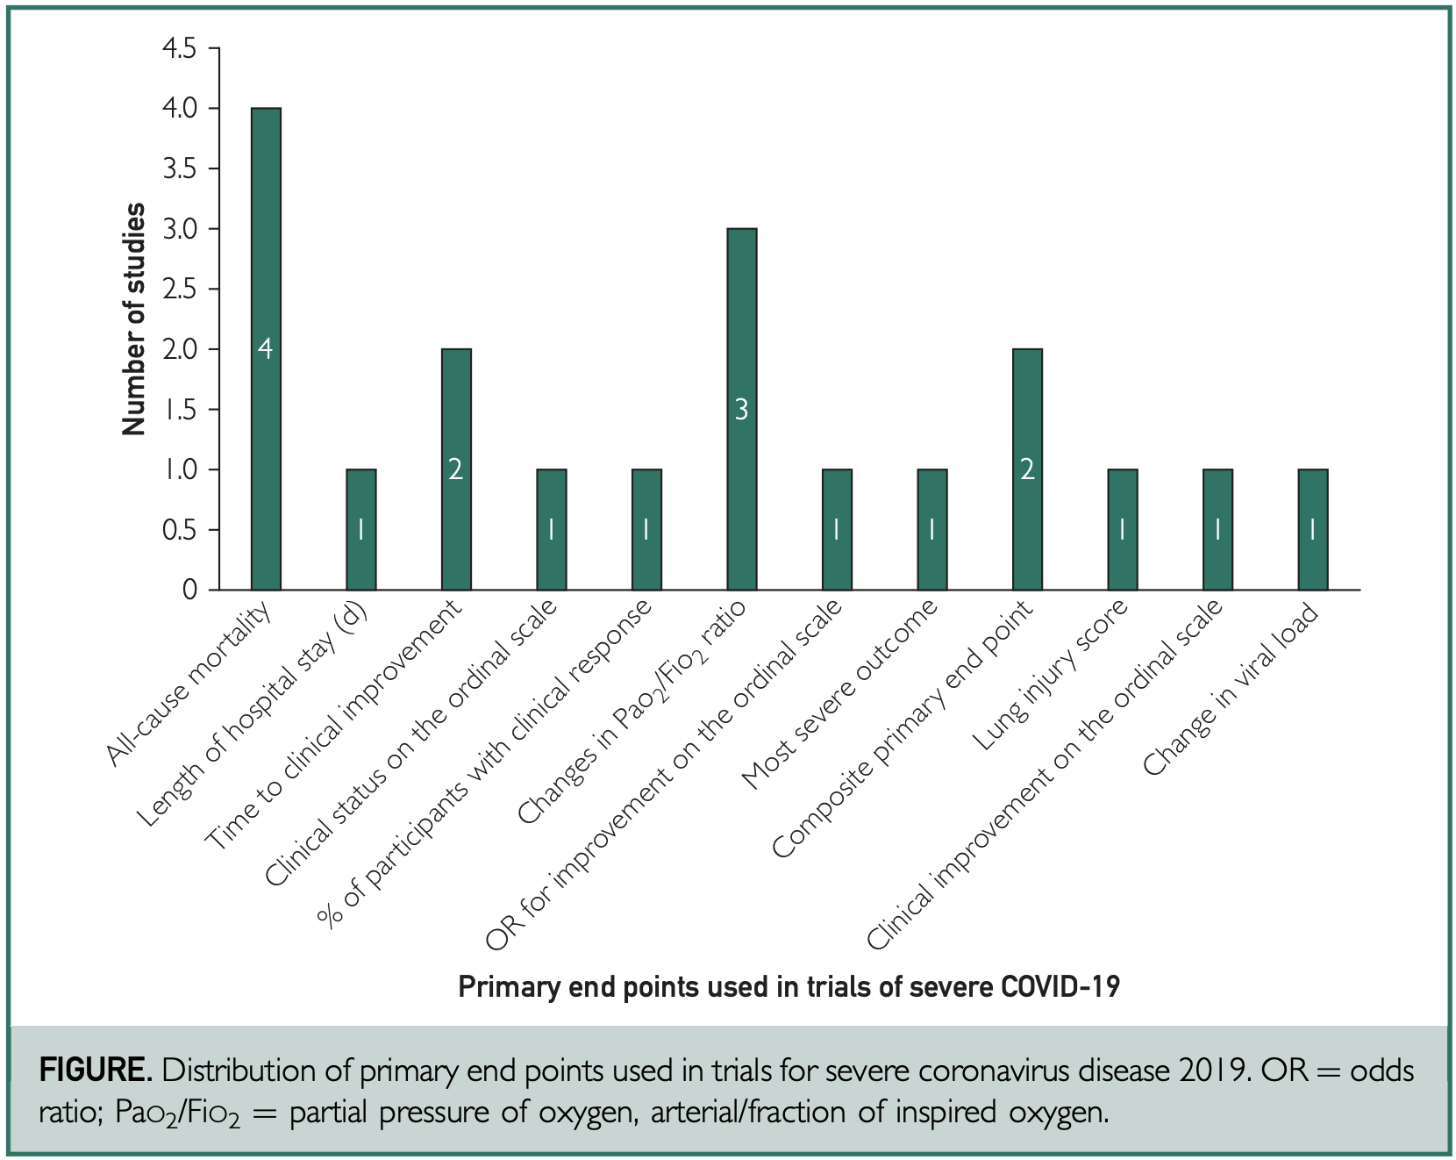
Choice of Endpoints
Variety of Endpoints
Some are context specific
Vary based on severity of illness

Slide 6
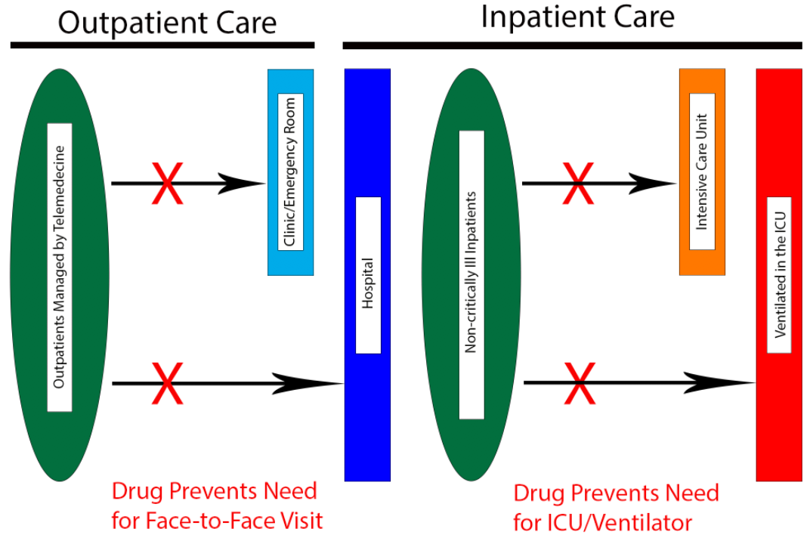
Evaluating Therapeutics
Ideal therapeutics:
Improve patient outcomes
Decrease transmission
Decrease health expenditure and use of limited resources
COVID-19 Ordinal Scale

Slide 7
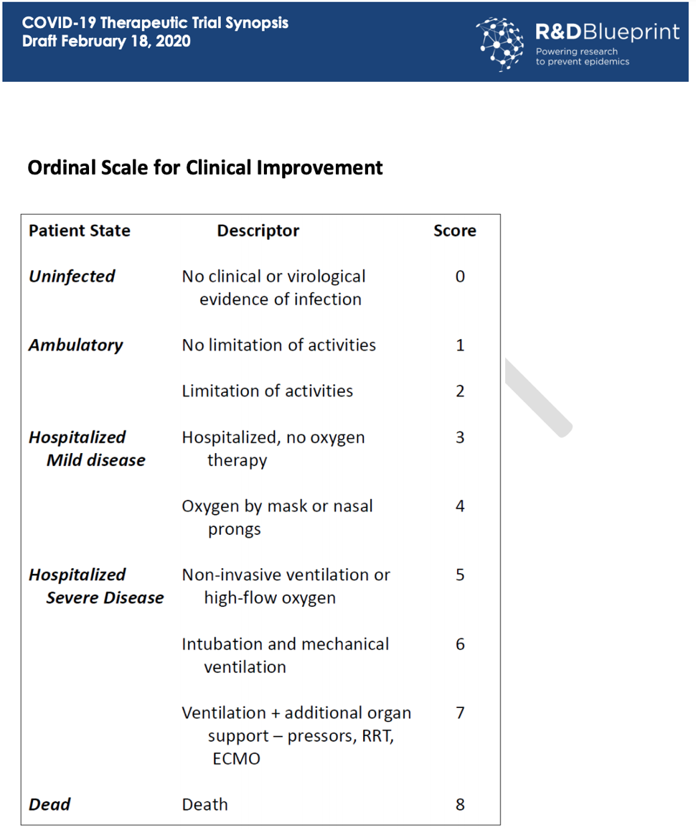
WHO Ordinal Scale
Assesses Across the Spectrum of Disease
Straightforward Assignment
Direct Clinical Relevance
Not Well Suited to EMR Data

Slide 8
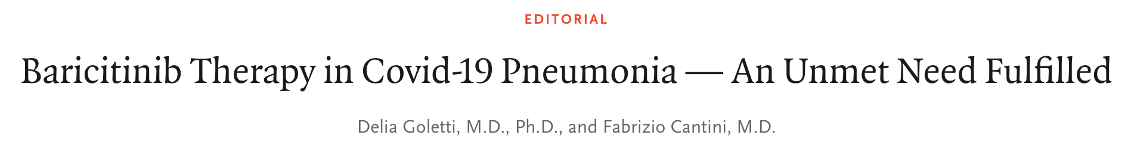

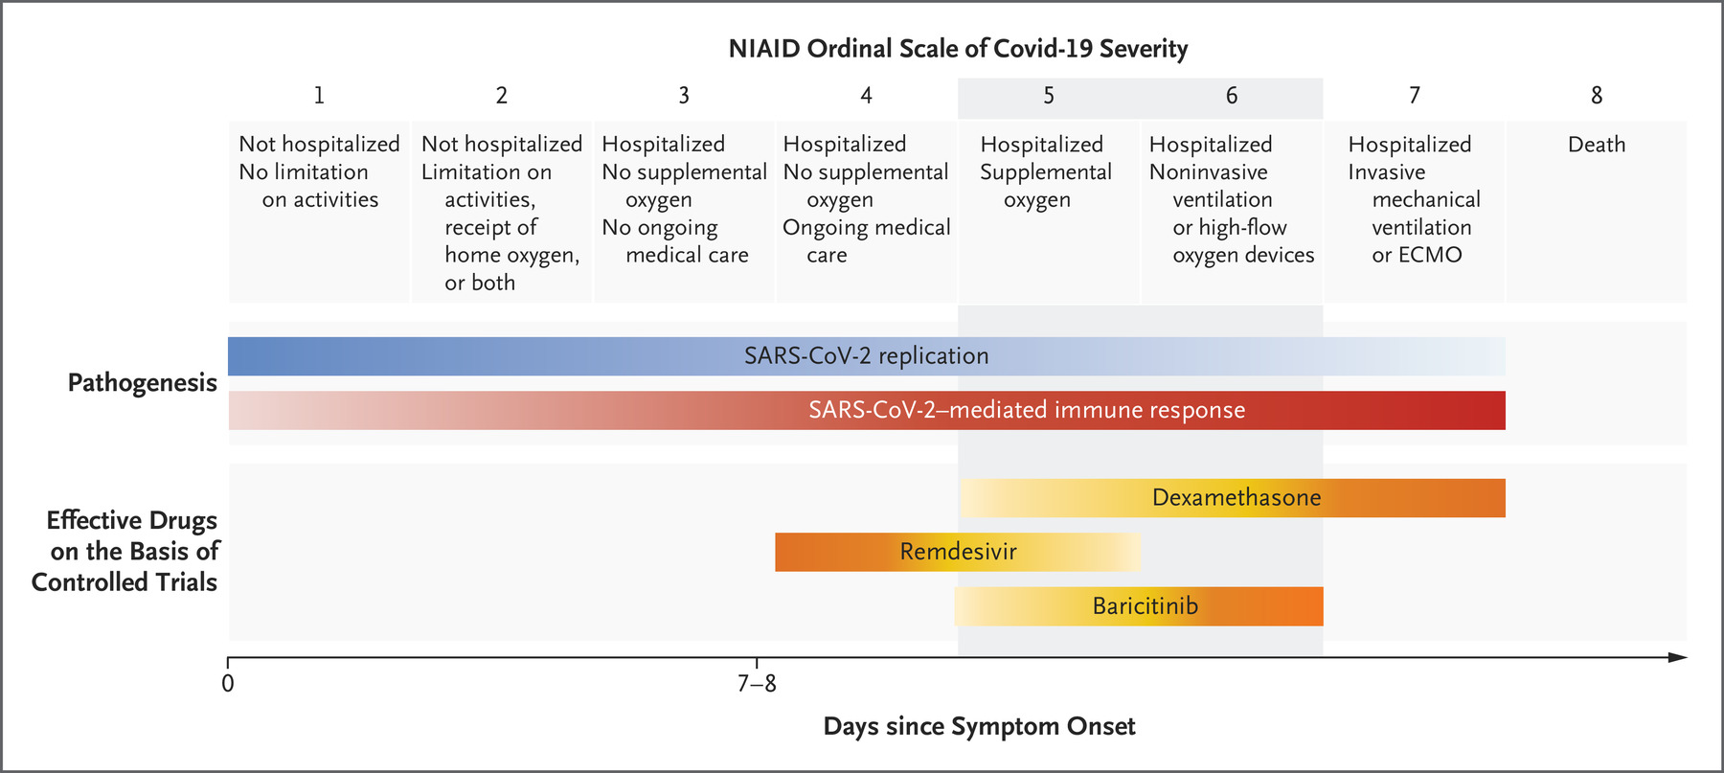
Evaluating Therapeutics
Ordinal Scale is Increasingly Used in Clinical Trials
High Utility for Judging Effect of Therapeutics

Slide 9
EMR Based Ordinal Scale
Ordinal Score (OS)
1 Outpatient
3 Hospitalized
5 Oxygen
7 Mechanical Ventilation
9 Organ Support
11 Death
Some ordinal scale indicators are not likely to be present in large, real world data sets
We present a novel and validated OS to fit the N3C

Slide 10
Performance of EMR OS
Ordinal Score (OS) | Week 1 N (%) | Week 2 N (%) | Week 3 N (%) | Week 4 N (%)
1 Outpatient | 1981532 (90.8) | 2064512 (94.6) | 2105214 (96.5) | 2119555 (97.1)
3 Hospitalized | 155518 (7.1) | 84889 (3.9) | 45194 (2.1) | 30613 (1.4)
5 Oxygen | 19038 (0.9) | 7696 (0.3) | 3475 (0.2) | 2108 (0.1)
7 Mechanical Ventilation | 15638 (0.7) | 7179 (0.3) | 4788 (0.2) | 3190 (0.1)
9 Organ Support | 1348 (0.1) | 709 (0.03) | 577 (0.02) | 421 (0.02)
11 Death | 9030 (0.4) | 17119 (0.8) | 22856 (1.0) | 26217 (1.2)
Distributions in EMR OS recapitulate distributions from CDC Data Sets

Slide 11
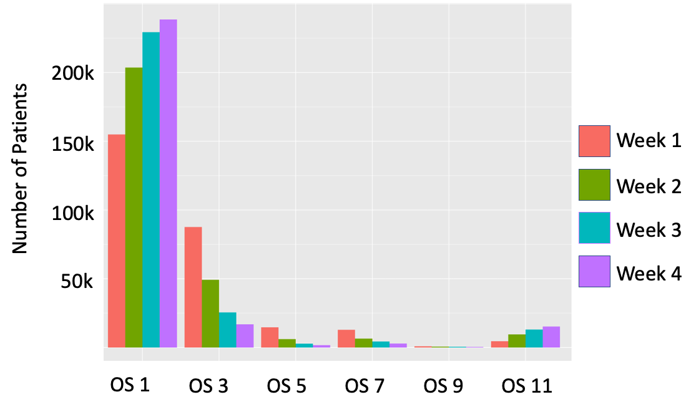
Changes over time in Patient Distribution

Slide 12
Can the EMR OS be used to assess treatment response across the N3C?

Slide 13
Concept Code Challenges in Evaluating Therapeutics
Straightforward
Nuanced
azithromycin 1000 MG Powder for Oral Suspension
azithromycin 1000 MG Powder for Oral Suspension [Zithromax]
azithromycin 20 MG/ML Oral Suspension
azithromycin 20 MG/ML Oral Suspension [Zithromax]
azithromycin 250 MG
azithromycin 250 MG Oral Capsule
azithromycin 250 MG Oral Capsule [Zithromax]
azithromycin 250 MG Oral Tablet
azithromycin 250 MG Oral Tablet [Azinthromycin]
azithromycin 250 MG Oral Tablet [Zithromax]
azithromycin 250 MG Oral Tablet [ZPAK]
azithromycin 40 MG/ML
azithromycin 40 MG/ML Oral Suspension
azithromycin 40 MG/ML Oral Suspension [Zithromax]
Azithromycin 500 MG Injectable Suspension
azithromycin 500 MG Injection
azithromycin 500 MG Injection [Zithromax]
azithromycin 500 MG Oral Tablet
azithromycin 500 MG Oral Tablet [Zithromax]
azithromycin 600 MG Oral Tablet
azithromycin 600 MG Oral Tablet [Zithromax]
azithromycin 900 MG Oral Suspension
heparin 5000 UNT Injectable Solution [Calciparine] Box of 10 by Choay Lab
heparin 20000 UNT Injectable Solution [Calciparine] Box of 10 by Choay Lab
heparin 10000 UNT/ML Injectable Solution Box of 10 by Sandoz
heparin 5000 UNT/ML Injectable Solution by Pfizer
heparin 2 UNT/ML Injectable Solution by Hospira
heparin 5000 UNT Injectable Solution [Calciparine] Box of 10
heparin 5000 UNT Injectable Solution
heparin 10000 UNT/ML Injectable Solution by Schering-Plough
heparin 20000 UNT Injectable Solution [Calciparine]
heparin Injectable Solution [Heparin Leo]
heparin 10 UNT/ML Injectable Solution by Hospira
heparin 1000 UNT/ML Injectable Solution [Heparin Leo]
heparin 1000 UNT/ML Injectable Solution by Fresenius
heparin 10000 UNT/ML Injectable Solution by Fresenius
heparin 100 UNT/ML Injectable Solution by Schering-Plough
heparin 25000 UNT/ML Injectable Solution [Calcilean] Box of 10
heparin 10000 UNT/ML Injectable Solution [Heparin Leo]
heparin Injectable Solution [Calciparine]
heparin 1000 UNT/ML Injectable Solution [Heparin Leo] by Leo
heparin 10000 UNT/ML Injectable Solution [Heparin Leo] by Leo
heparin 20000 UNT Injectable Solution [Calciparine] Box of 10
heparin 20000 UNT Injectable Solution

Slide 14
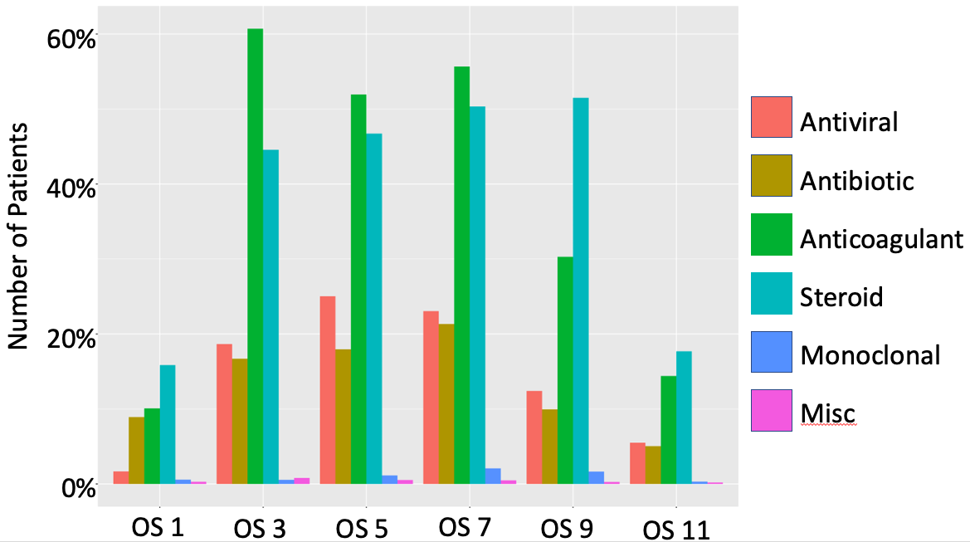
Use of Therapeutics By EMR OS Designation

Slide 15
Thank You
Questions:
zach.porterfield@uky.edu

Slide 16
IDeA-CTR N3C Investigator Engagement Event:
Jumpstarting Access to Clinical Data
for COVID-19 Research
Thursday, February 17, 2022 | 2:00-5:00 PM EST
CTR N3C Studies
What is the Best Therapy for COVID-19?
J. Zachary Porterfield, MD, PhD
Assistant Professor of Microbiology, Immunology & Molecular Genetics & Infectious Diseases
University of Kentucky
Bradley S. Price, PhD
Assistant Professor of Business Data Analytics
West Virginia University
U54GM104942-06S4

Slide 17
Collaboration Is the Key!
Maryam Khodaverdi¹, Hamidreza Moradi², H. Timothy Bunnnell³, James Z. Porterfield⁴,
Michael T. Vest⁵, Susan L. Santangelo⁶, Wesley Kimble¹, Alfred J. Anzalone⁷, Jeremy Harper⁸, Brian Hendricks⁹, Sally L. Hodder¹
¹West Virginia Clinical and Translational Science Institute, Morgantown, WV, United States
²University of Mississippi Medical Center, Jackson, MS, United States,
³Nemour's Children's Health, Wilmington, DE,
⁴University of Kentucky, Lexington, KY, United States,
⁵Christiana Care Health System, Newark, USA,
⁶Tufts University, Boston, MA, United States,
⁷University of Nebraska Medical Center, Omaha, NE, United States,
⁸Owl Health Works LLC, Indianapolis, IN
⁹ West Virginia University, Morgantown, WV

Slide 18
Acknowledgements
The project described was supported by the National Institutes of Health, U54GM104942-05S2, U54GM104941, U54GM115516, U54 GM115458, The analyses described in publication were conducted with data or tools accessed through the NCATS N3C Data Enclave supported by NCATS U24 TR002306. The content is solely the responsibility of the authors and does not necessarily represent the official views of the NIH.

Slide 19
Objective
Efficacy and safety of various COVID-19 treatments have usually been studied with prospective, randomized clinical trials (RCT). However, the limited sample sizes of RCTs often limit their utility, especially for subsets of patients. Retrospective analyses using very large datasets enable investigation of various therapeutic outcomes among patients with differing levels of disease severity.
This study seeks to find the best therapy or combination of therapeutic agents for subsets of patients with various levels of COVID-19 disease severity.

Slide 20
What Did We Think About?
Can we predict a hospitalized patient’s 28 day outcome and understand treatment and clinical care practices related to this outcome?
Outcome of Interest Should Be Based on Severity
  Defining severity daily vs weekly? Daily variation can cause problems.
  Is it binary? Discharged or not? Is it a decrease in severity? Is it understanding transitions through severity?
Covariate Issues: BMI, Co-morbidities, Vaccination, Introduction of Variant, Time represented in N3C

Slide 21
Data
Using the National COVID Cohort Collaborative (N3C), containing data on 3,756,433 SARS-CoV-2 infected persons from 69 centers across the United States, disease severity was defined using a 6-level ordinal scale (OS).
Baseline OS for each patient was defined as the maximum OS level that occurred in the first 7 days (Week 1) after COVID-19 diagnosis.
The Charlson Co-morbidity Index (CCI) was used to the measure the number of co-morbidities
Age>60 years, ethnicity, quarter of diagnosis, and treatments are independent variable

Slide 22
Data
Treatment categories include anti-coagulants (AC), steroids, antibiotics, antivirals (AV), monoclonal antibodies (MA), and a miscellaneous group that included all other treatments.
Data were collected from Q2 2020 to Q4 2021 and stratified by before and after Q3 2021 to investigate the effect of the Delta variant. At the time of analysis, there are very limited data on the Omicron variant, as pooled data is aggregated from all sites.

Slide 23
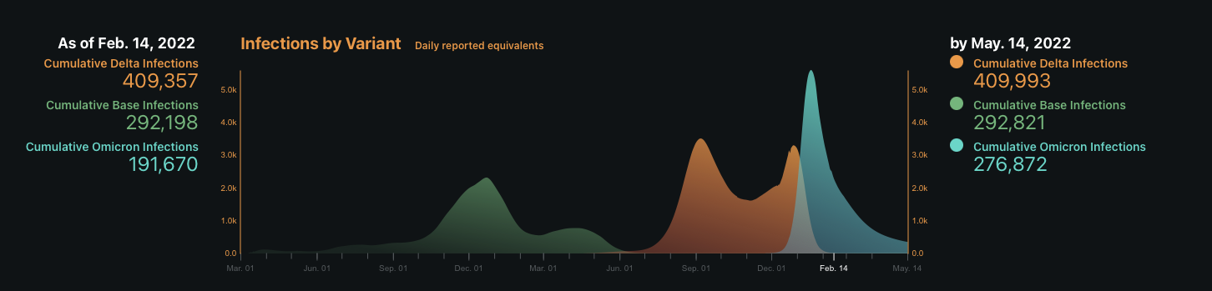

Slide 24
Methodological Approaches
Use Quarter of Diagnosis as an indicator of variant for (Alpha/Delta) split.
Model probabilities of severity, conditioned on starting severity at hospitalization.
Needed tools with automatic variable selection that maintained interpretability for clinical decisions.
  Use Elastic Net Penalized Multinomial Regression to mix probabilistic modeling with traditional interpretation from multi-class models.

Slide 25
Methodological Approaches
The Goal of the Model:
Pr(Week 4 OS is Level Y | Covariates, Week 1 OS is Level X, Pre or Post Delta)
Different Levels of Severity Will Require Different Treatments
  Use interactions with Monoclonal Antibodies and All Other Treatments for Models that consider Week 1 OS 3 or Week 1 OS 5
  Use interactions with Steroids and All Other Treatments for Models that Consider Week 1 OS 7 or Week 1 OS 9
All Models Consider Interactions of CCI with Each Treatment to Better

Slide 26
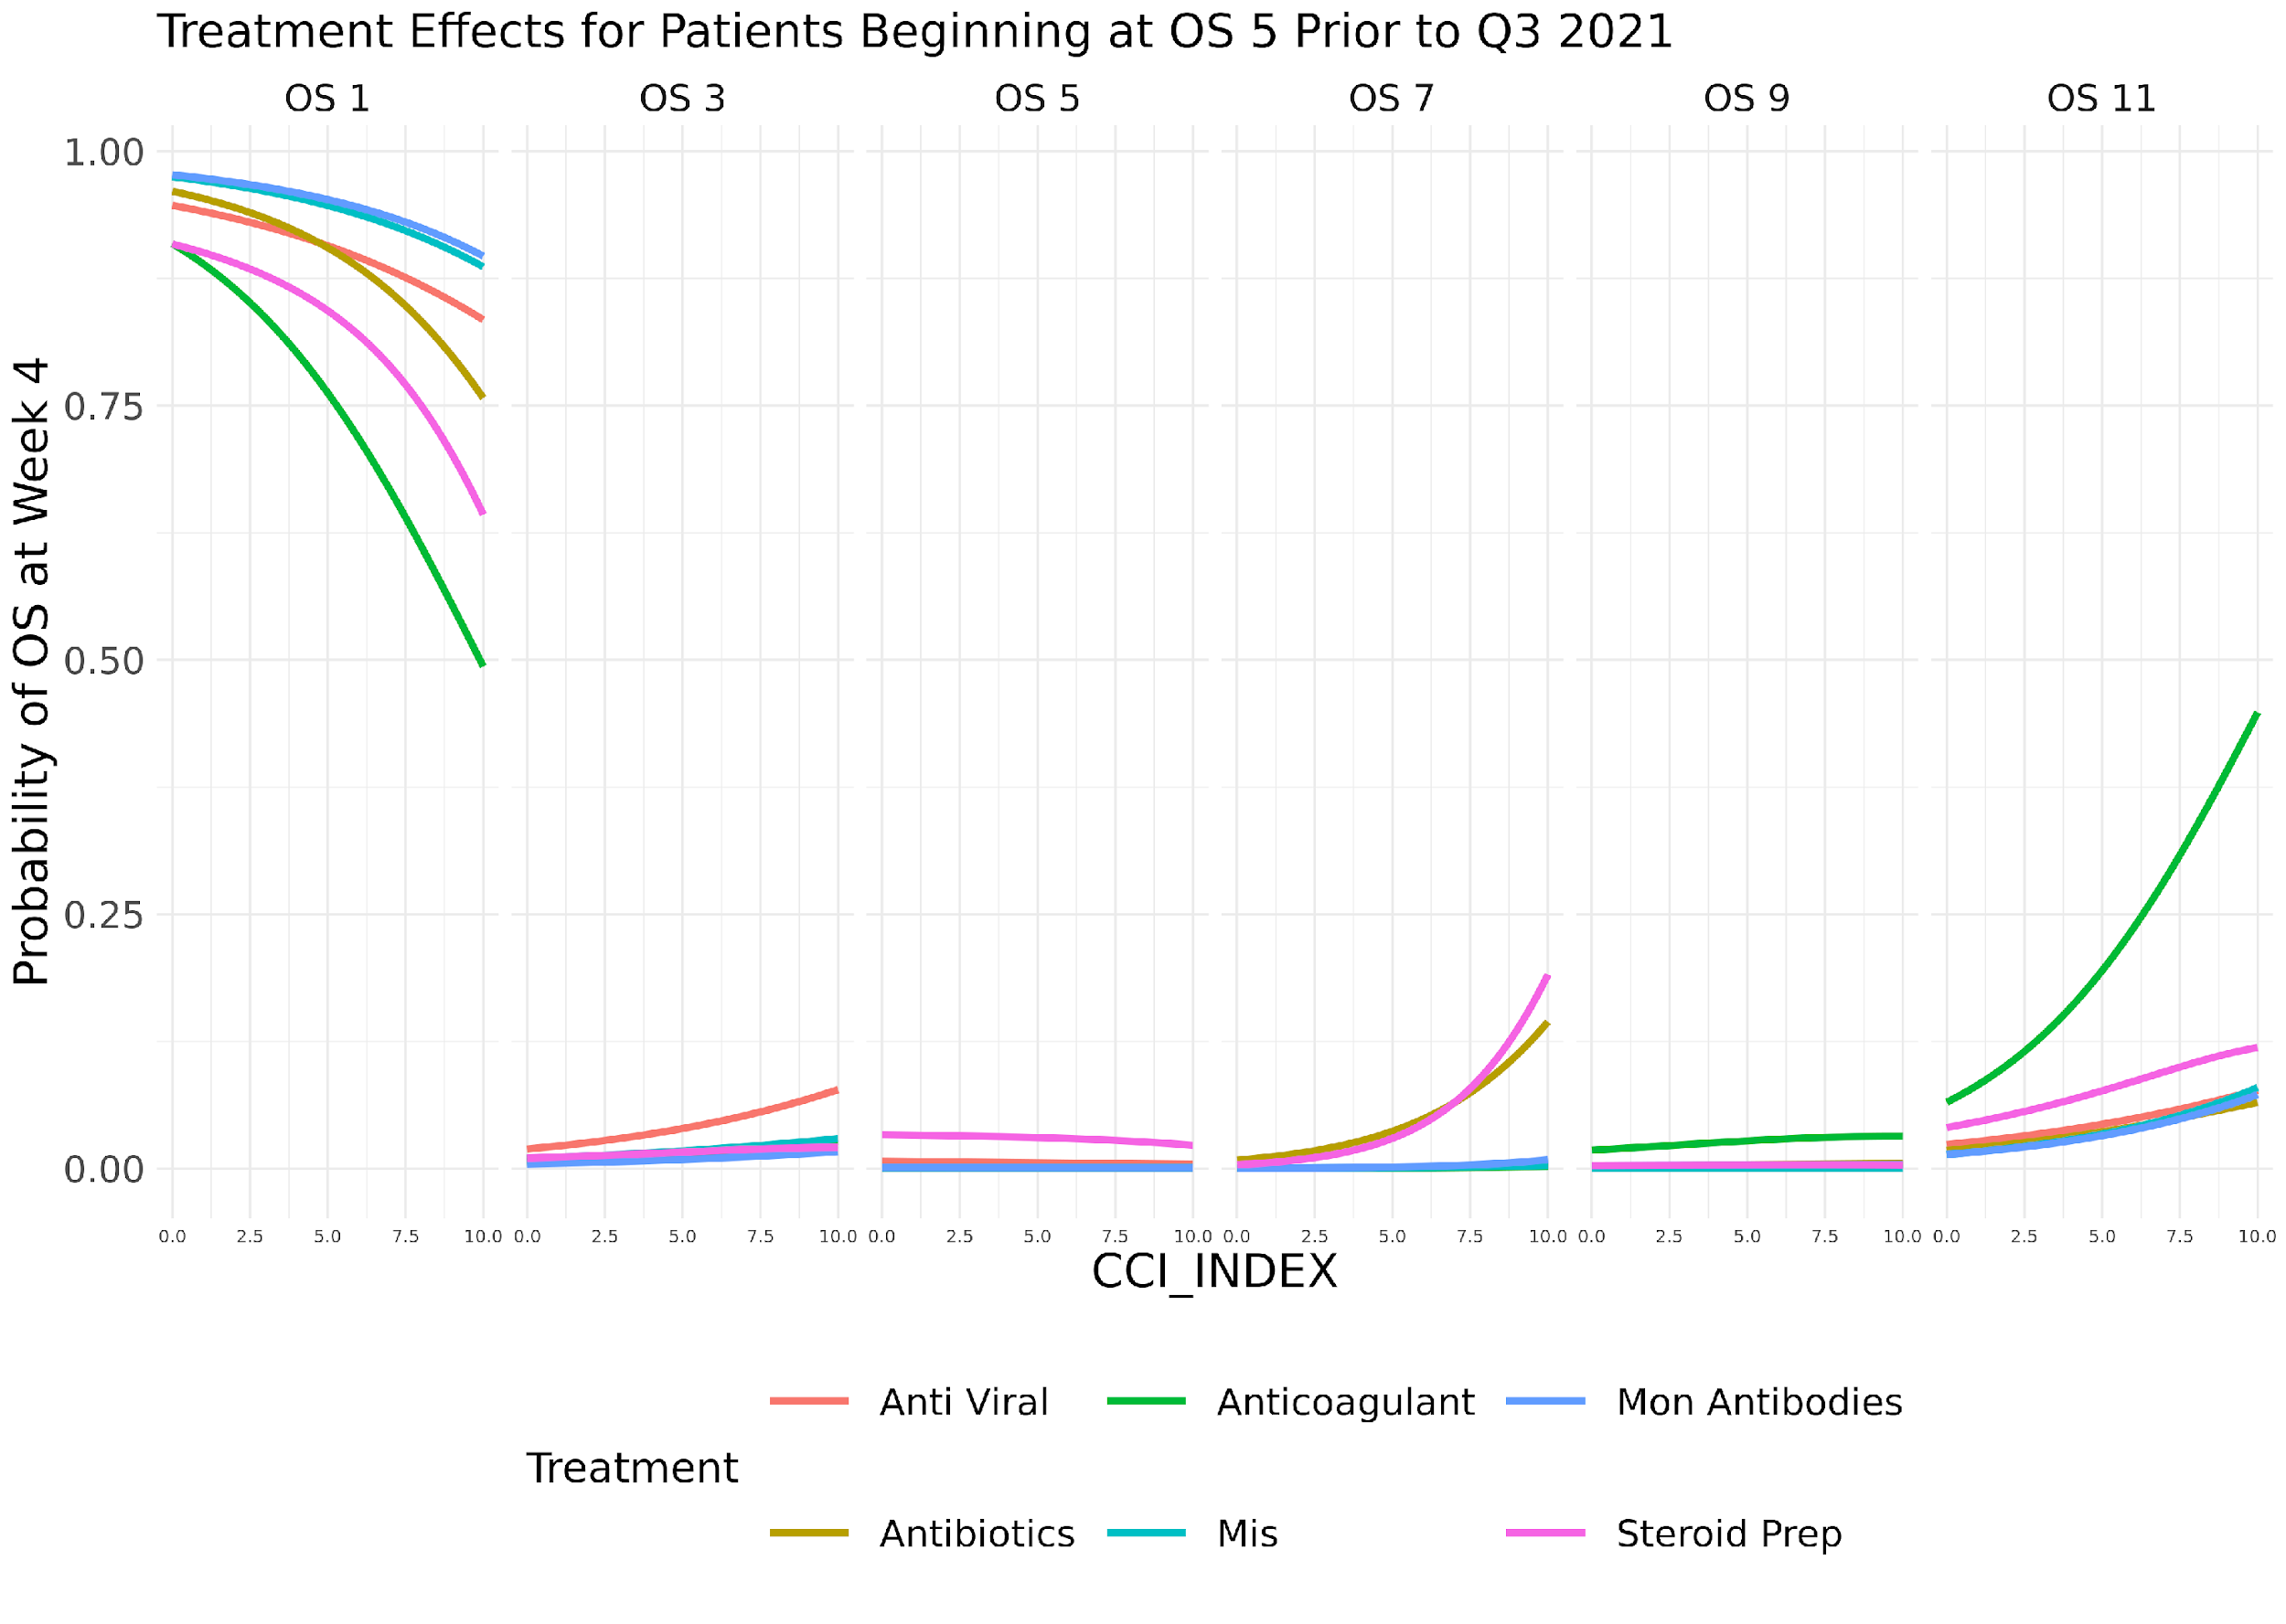

Slide 27
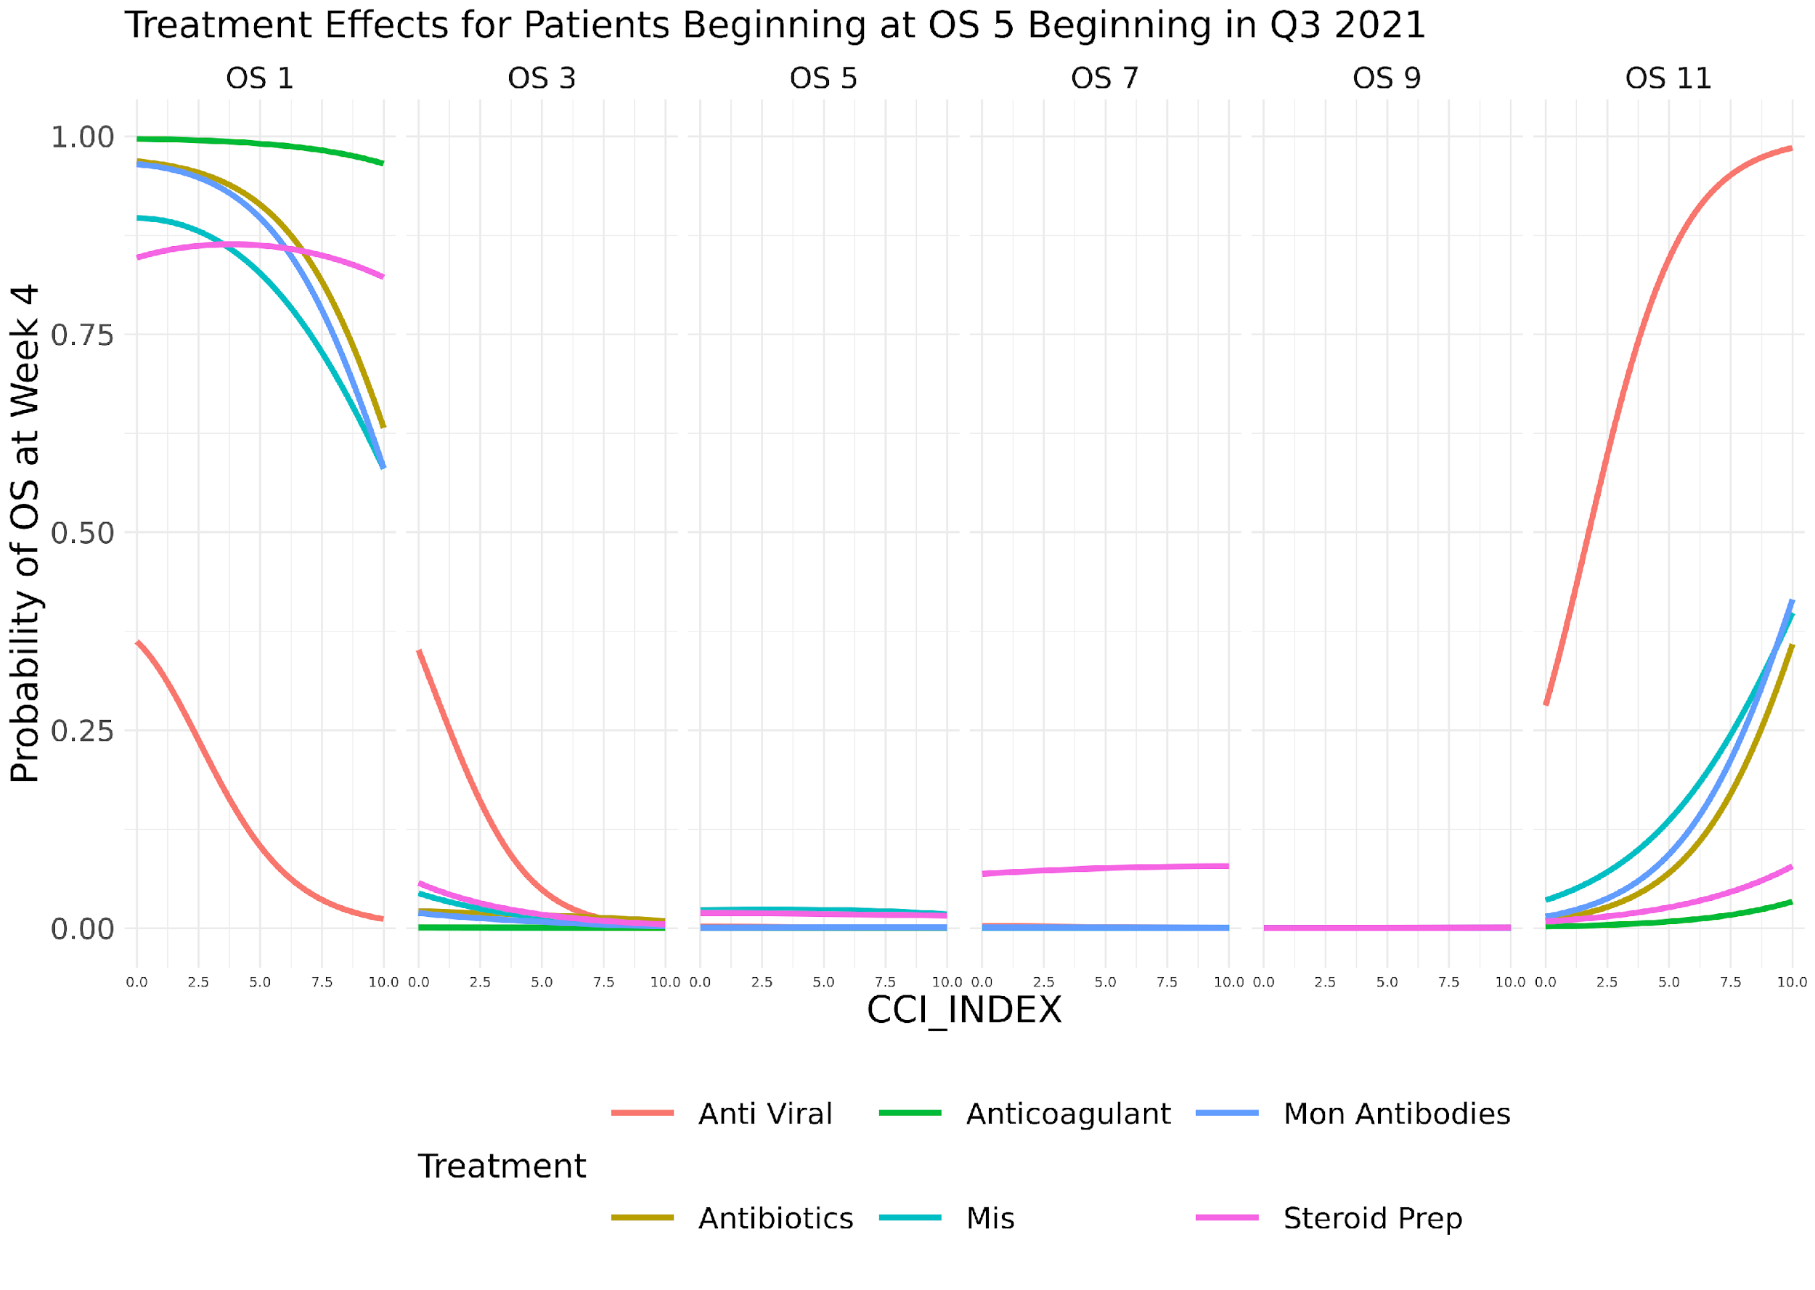

Slide 28
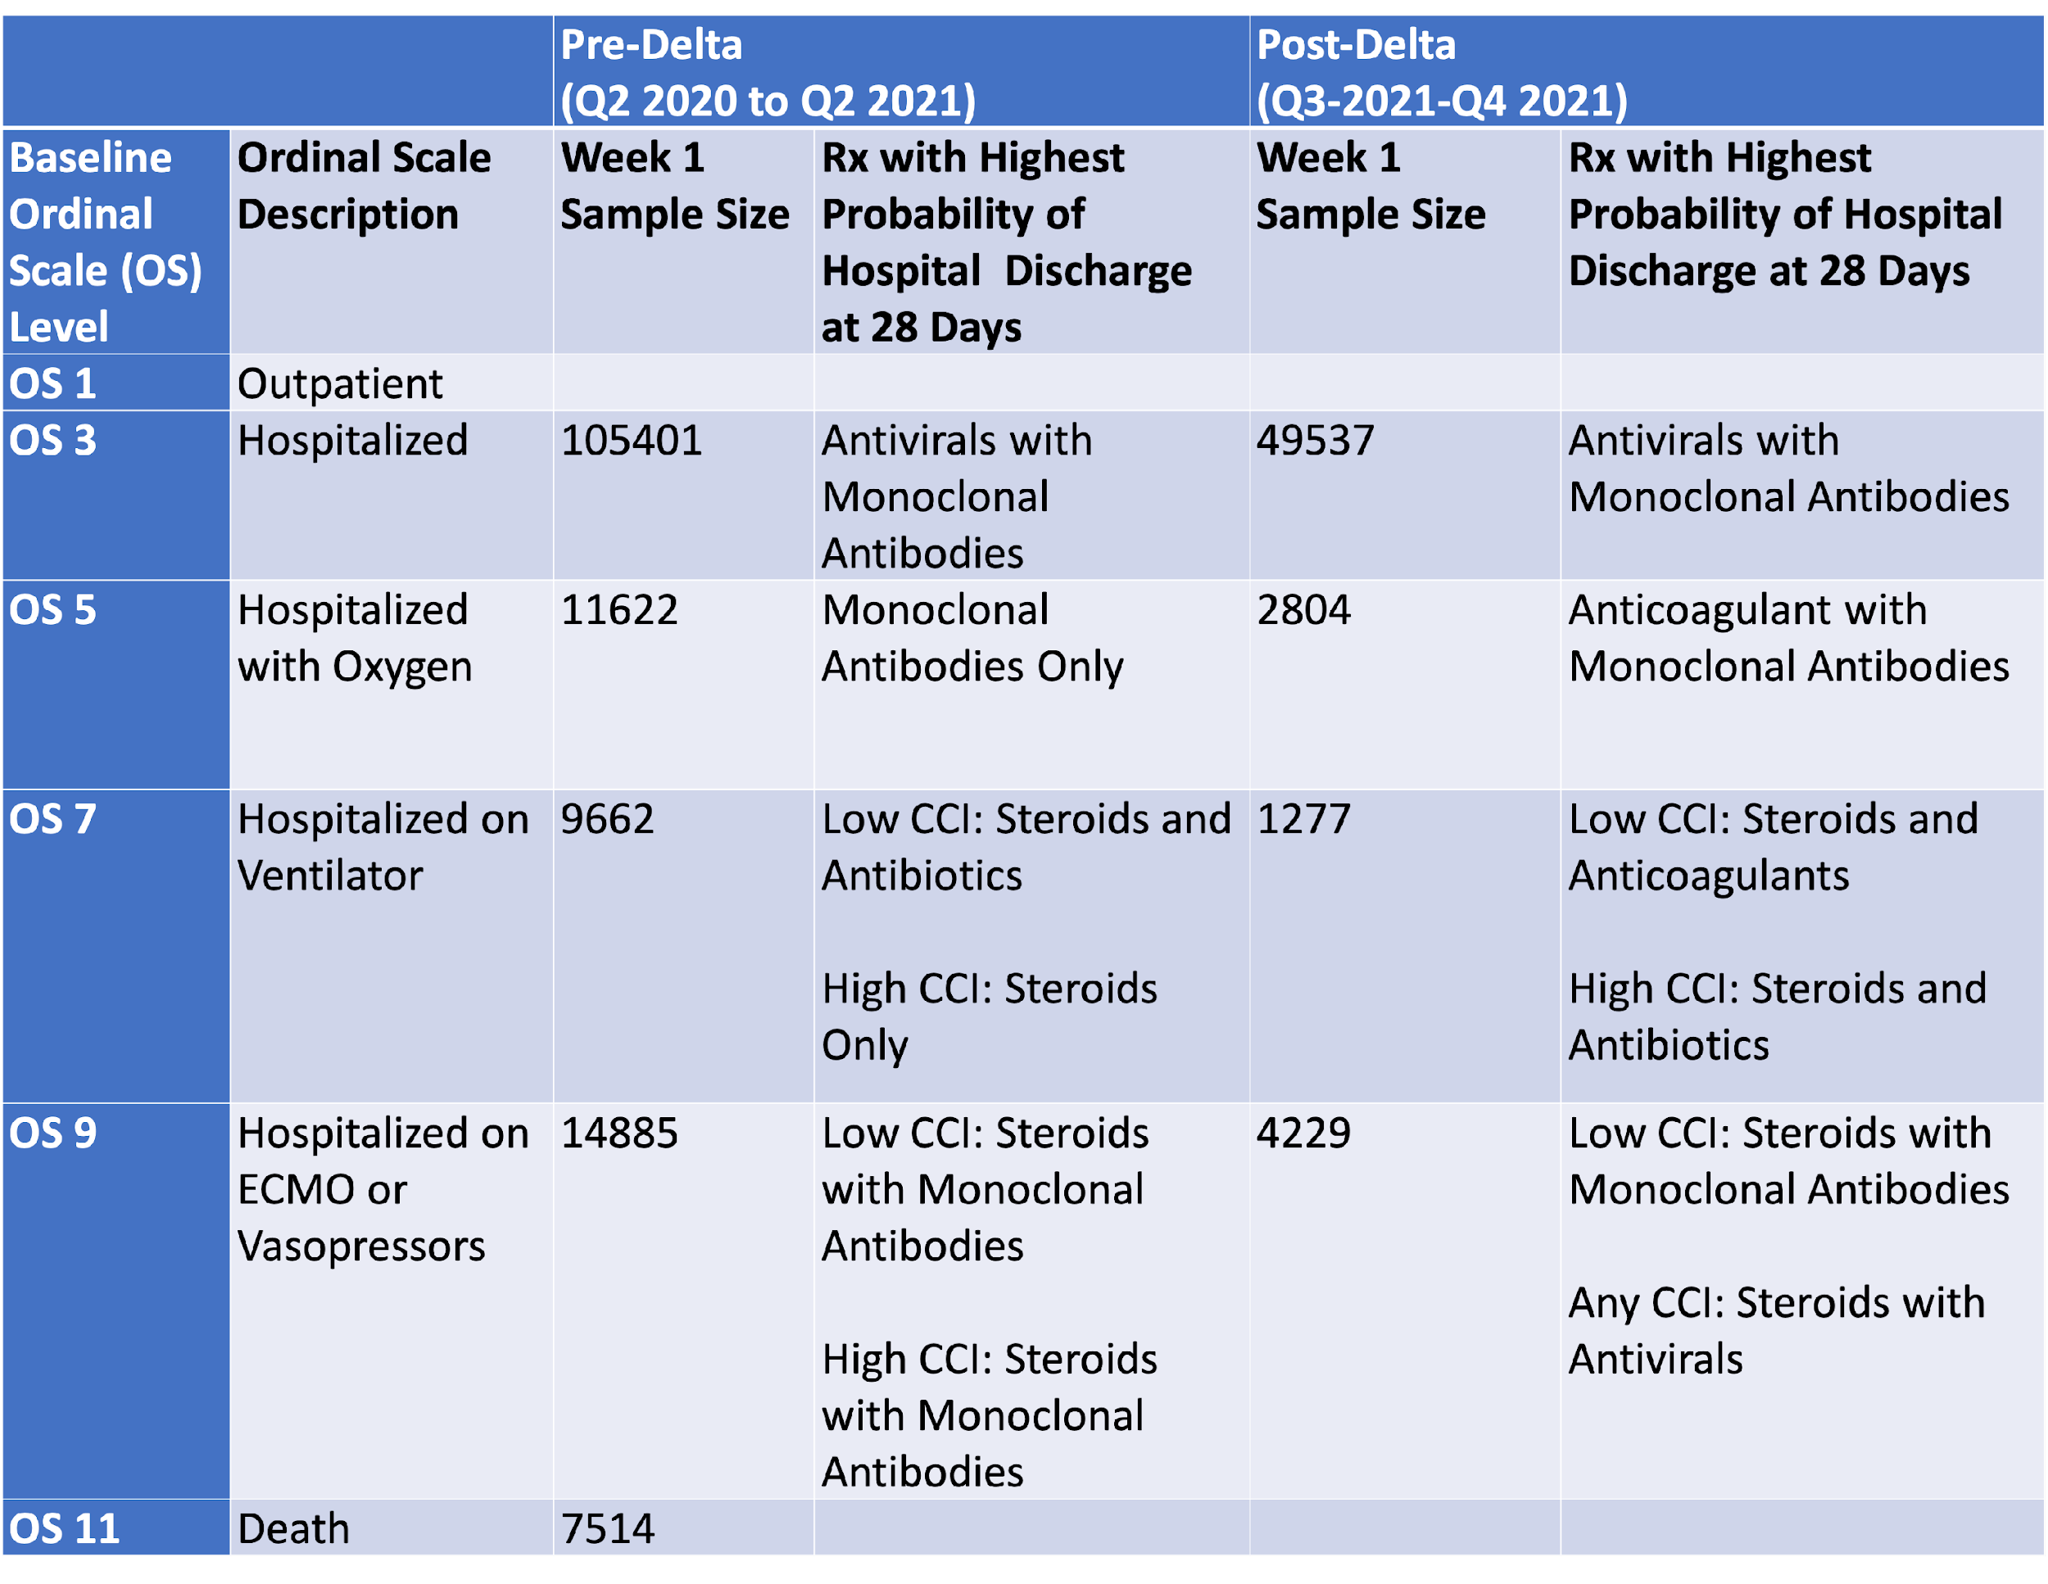
Methodological Approaches
 |  | Pre-Delta (Q2 2020 to Q2 2021) |  | Post-Delta (Q3-2021-Q4 2021)
Baseline Ordinal Scale (OS) Level | Ordinal Scale Description | Week 1 Sample Size | Rx with Highest Probability of Hospital Discharge at 28 Days | Week 1 Sample Size | Rx with Highest Probability of Hospital Discharge at 28 Days
OS 1 | Outpatient
OS 3 | Hospitalized | 105401 | Antivirals with Monoclonal Antibodies | 49537 | Antivirals with Monoclonal Antibodies
OS 5 | Hospitalized with Oxygen | 11622 | Monoclonal Antibodies Only | 2804 | Anticoagulant with Monoclonal Antibodies
OS 7 | Hospitalized on Ventilator | 9662 | Low CCI: Steroids and Antibiotics High CCI: Steroids Only | 1277 | Low CCI: Steroids and Anticoagulants High CCI: Steroids and Antibiotics
OS 9 | Hospitalized on ECMO or Vasopressors | 14885 | Low CCI: Steroids with Monoclonal Antibodies High CCI: Steroids with Monoclonal Antibodies | 4229 | Low CCI: Steroids with Monoclonal Antibodies Any CCI: Steroids with Antivirals
OS 11 | Death | 7514

Slide 29
Other Interesting Results
Across all baseline OS levels, no one standard combination of treatments provides the highest probability of hospital discharge at Week 4.
Being male and older than age 60 years are associated with lower probabilities of hospital discharge by Week 4.
Higher CCI is associated with a higher probability of death by Day 28 and lower CCI values lead to a higher probability of hospital discharge, except for those starting at OS Level 7.
Variants (Delta vs previous variants) influence the most effective combination of therapeutics.

Slide 30
Conclusions and Limitations
These data suggest that optimal therapeutic agent choice may be guided by the level of disease severity and presence of specific SARS-CoV-2 variant.
The assessed treatment regimes confirmed previously identified efficacious treatments, e.g., steroids and MA, but also suggest the potential for positive impact of other treatments combinations.
As this is a retrospective analysis, therefore, unrecognized confounding may be present.
Demonstrated associations may not be causal. However, unlike RCTs, use of very large datasets such as N3C enables investigation of optimal treatments for subsets of patients defined by disease severity.

Slide 31
Thank You!
Any Questions?
E-Mail: brad.price@mail.wvu.edu
Website: www.bradprice.io

Slide 32
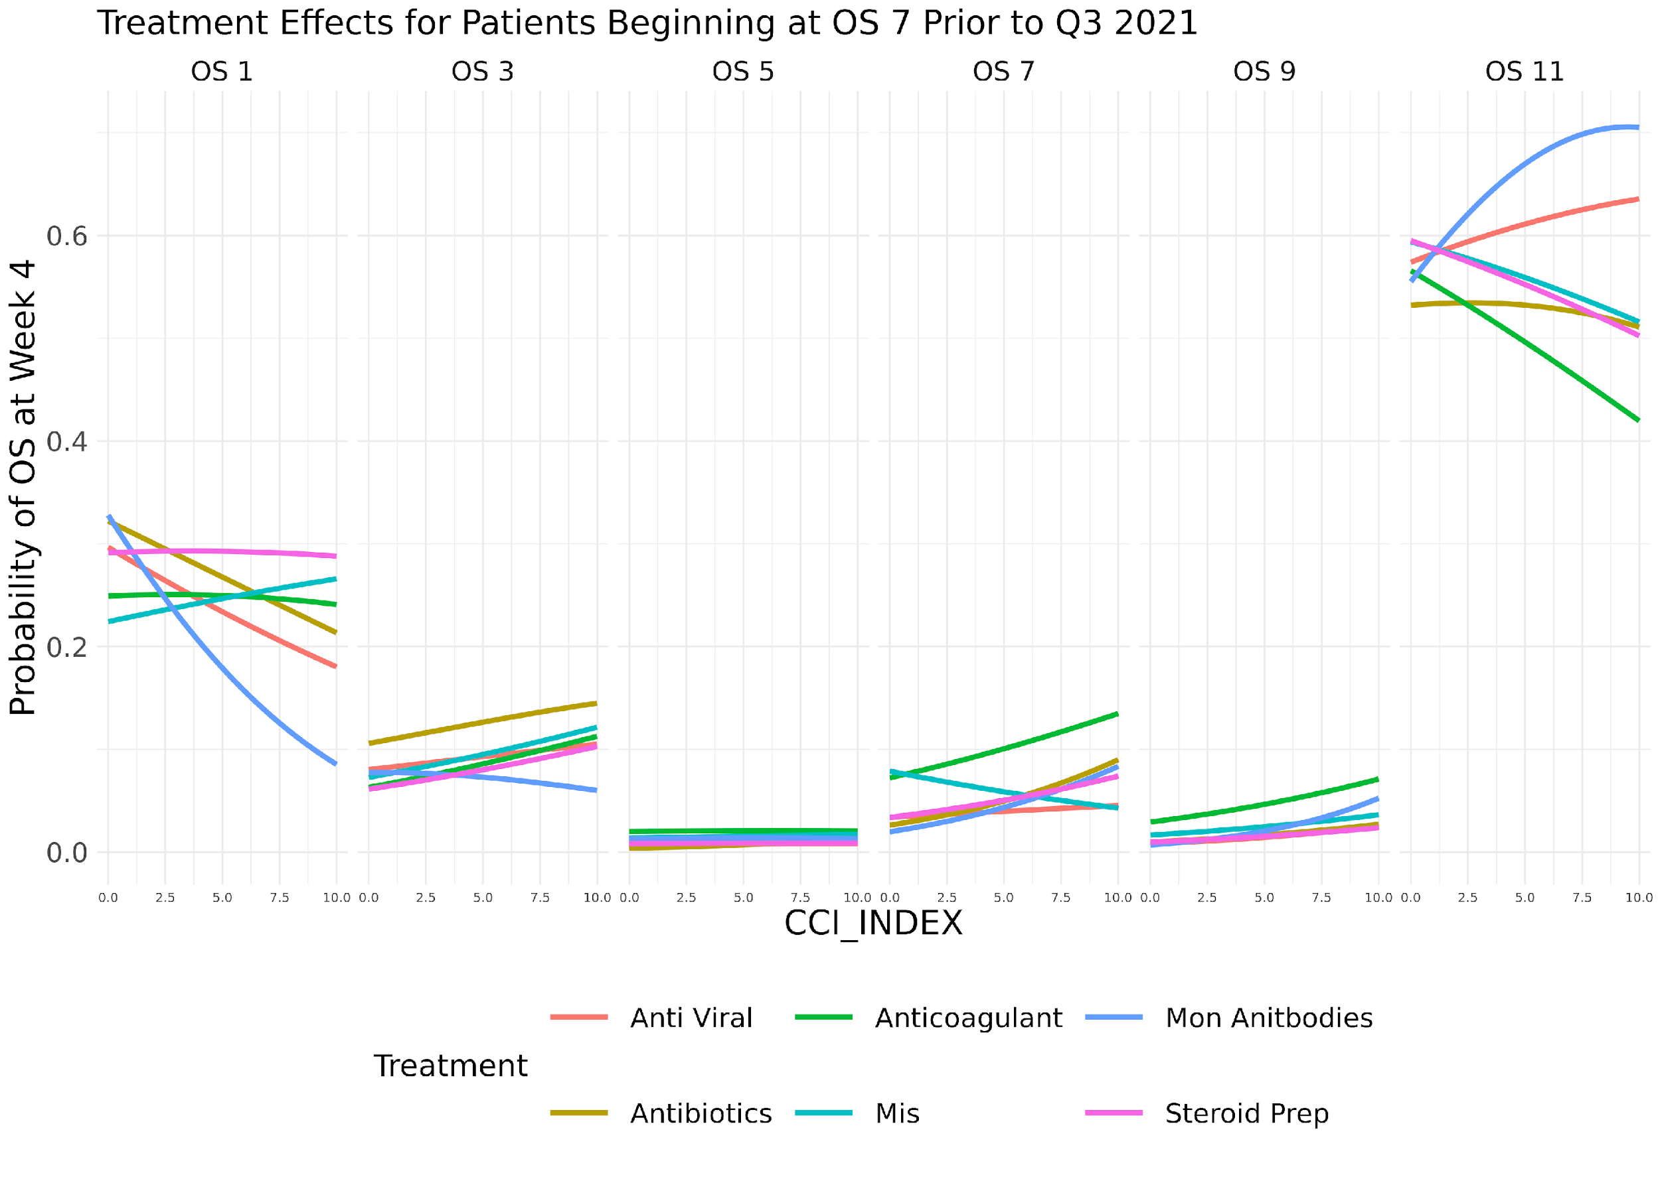

Slide 33
