Slide 1


Getting Started with N3C
Shawn T. O’Neil, N3C Training Coordinator
@data2health
@ncats_nih_gov
https://covid.cd2h.org/
Notes:
Welcome to orientation - Session A of A & B
For anyone new to N3C, especially for those with research ideas
Session B covers technical topics, both useful even for cracker-jack data scientists

Slide 2


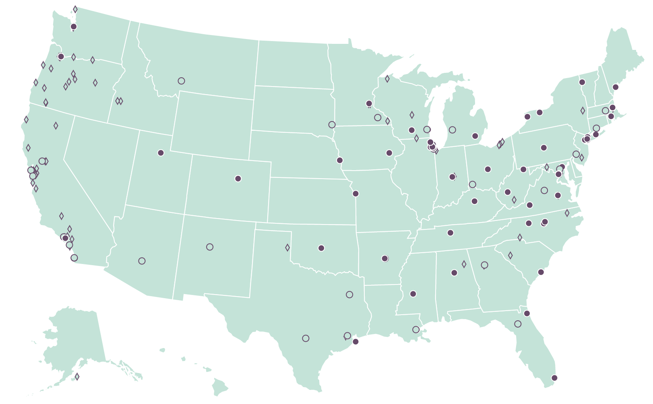
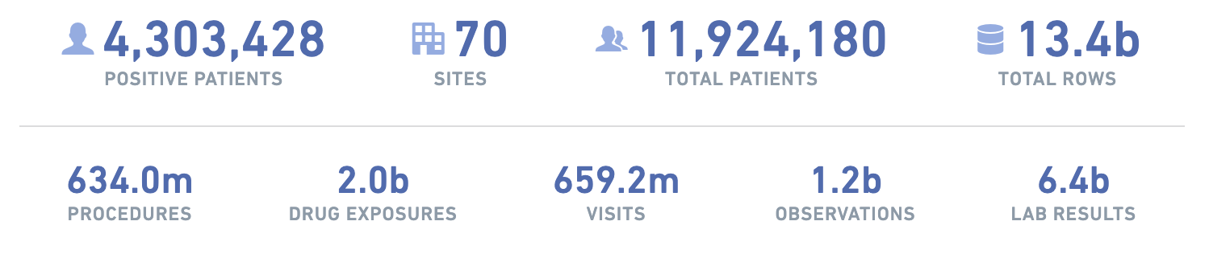
Data Partners
A program of NIH’s National Center for Advancing Translational Sciences
Each Data Partner:
  Identify COVID+ Patients
  and
  2X others w/ best match on: age, sex, race, gender
  then
  Pull all data from 1/1/2018 on
Create a “Release”
  Every 1 to 2 weeks
  All prior releases available
Notes:
N3C knowledge is distributed, this orientation wouldn’t be without the help of these subject matter experts and their help
They are present (today) to answer questions: feel free to pose questions in the chat and I’ll pause yacking periodically to see if there are any quick ones, we can do more Q&A after
Shawn is me

Slide 3

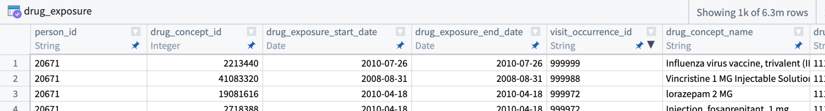
Data Model
A program of NIH’s National Center for Advancing Translational Sciences
Harmonized to OMOP Common Data Model
Coordinating measurements/units
Quality checks
Well-defined hierarchy of medical concepts
  “All non-bacterial pneumonias”
  “Drugs containing ciprofloxacin”
  “All COVID-19 PCR tests”
Info in Tables: Demographics, Drugs, Labs, Conditions, Procedures, Visits, …
Example (notional, i.e. fake) data:
Notes:
N3C knowledge is distributed, this orientation wouldn’t be without the help of these subject matter experts and their help
They are present (today) to answer questions: feel free to pose questions in the chat and I’ll pause yacking periodically to see if there are any quick ones, we can do more Q&A after
Shawn is me

Slide 4
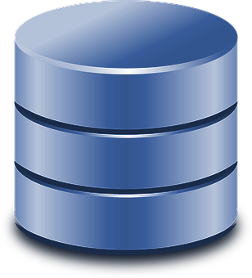
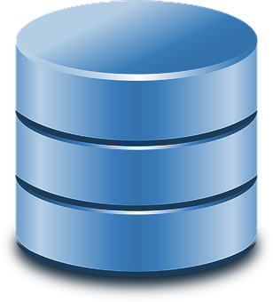
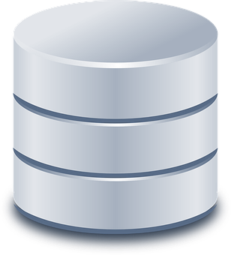
Data “Levels”
A program of NIH’s National Center for Advancing Translational Sciences
Limited Dataset (HIPAA)
Dates + 5-digit Zips
All below, and
Letter of Determination from your local IRB
Level 3
OMOP
De-Identified Data (HIPAA)
Random* dates + 3-digit Zips
*(+/- 180 days, per person ID)
All below, and
Human Subjects Research Protection
Training (e.g. CITI)
Level 2
OMOP
Synthetic Data
Researcher-specified elements via statistical model
N3C Registration
Data Use Agreement
NIH IT Security Training
Level 1
Custom
Which level is right for your project? Ask your CTR Investigator Navigator!
Notes:
N3C knowledge is distributed, this orientation wouldn’t be without the help of these subject matter experts and their help
They are present (today) to answer questions: feel free to pose questions in the chat and I’ll pause yacking periodically to see if there are any quick ones, we can do more Q&A after
Shawn is me

Slide 5
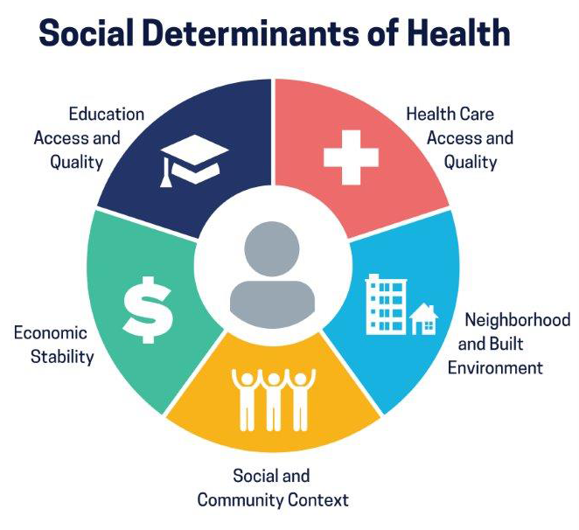
“External” Data
A program of NIH’s National Center for Advancing Translational Sciences
Census data? FDA datasets?
Social determinants data? We’ve got it!
> 35 Available for use
Reviewed for security & licensure
Want to import your favorite?
Ask your CTR Investigator Navigator!
Notes:
N3C knowledge is distributed, this orientation wouldn’t be without the help of these subject matter experts and their help
They are present (today) to answer questions: feel free to pose questions in the chat and I’ll pause yacking periodically to see if there are any quick ones, we can do more Q&A after
Shawn is me

Slide 6
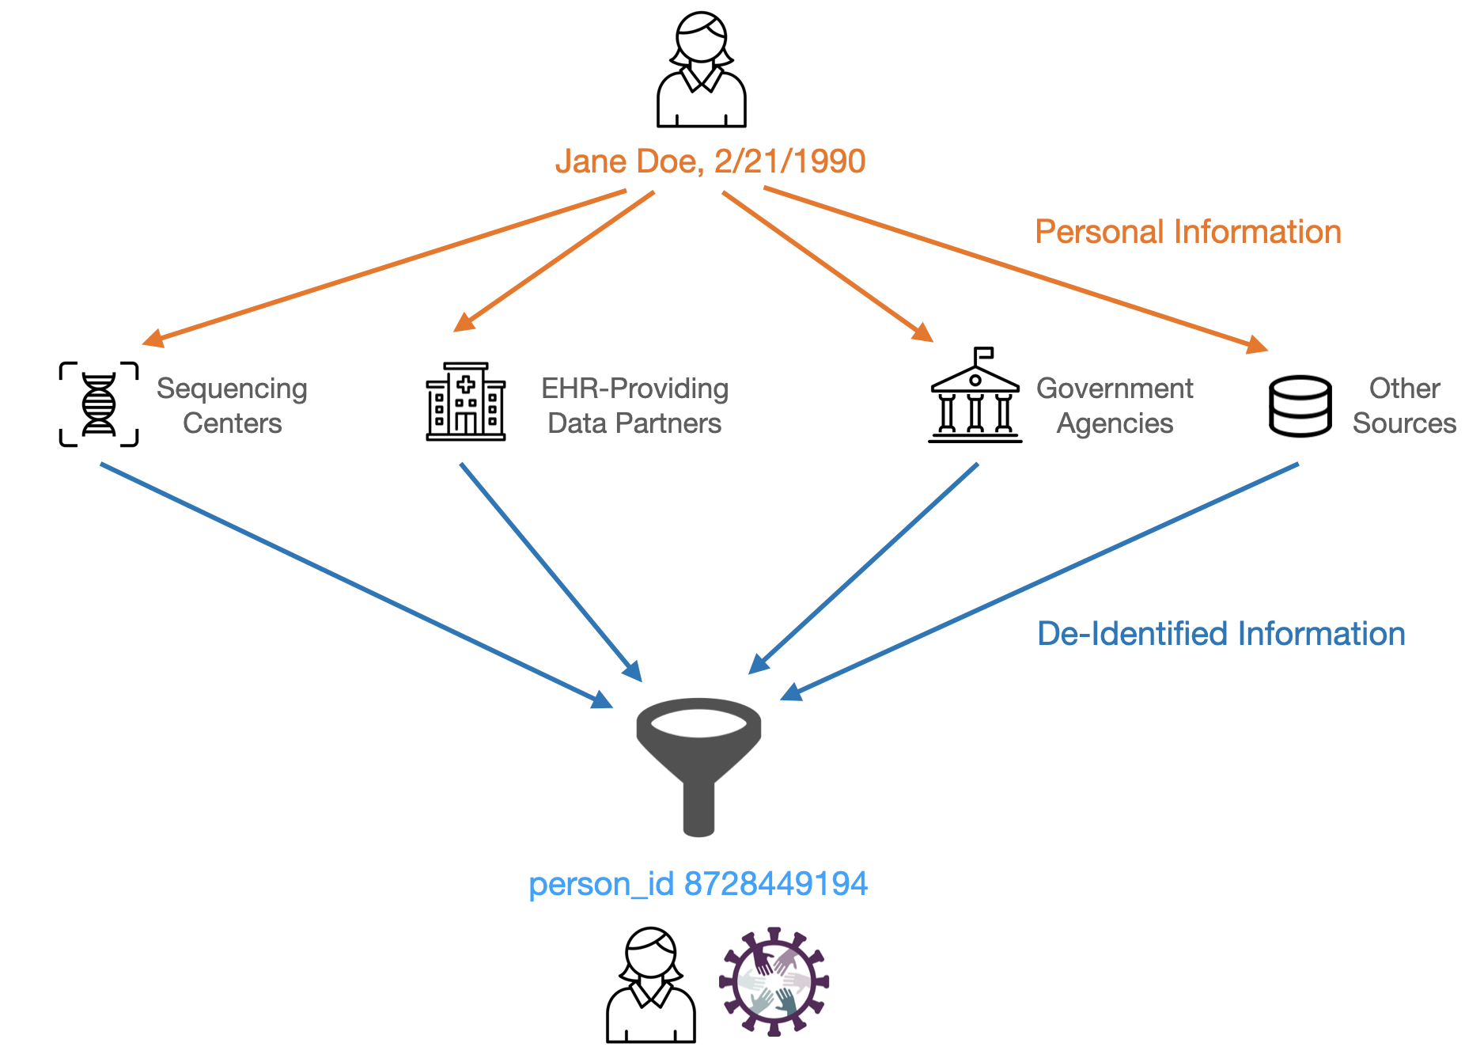
NEW! Privacy-Preserving Record Linkage
A program of NIH’s National Center for Advancing Translational Sciences
PPRL: Securely linking N3C data against additional sources
Mortality - Live Now
Mortality info from data partners is spotty, private and government sources help fill the gaps
Viral Variants - Coming Soon
For select patients, sequenced variant info
WHO (delta, omicron, …), PANGO (B.1.617.2)
Strain sequence data (SNPs) eventually
Available w/ Level 3 request only (IRB required)
More info at https://covid.cd2h.org/pprl
Notes:
N3C knowledge is distributed, this orientation wouldn’t be without the help of these subject matter experts and their help
They are present (today) to answer questions: feel free to pose questions in the chat and I’ll pause yacking periodically to see if there are any quick ones, we can do more Q&A after
Shawn is me

Slide 7
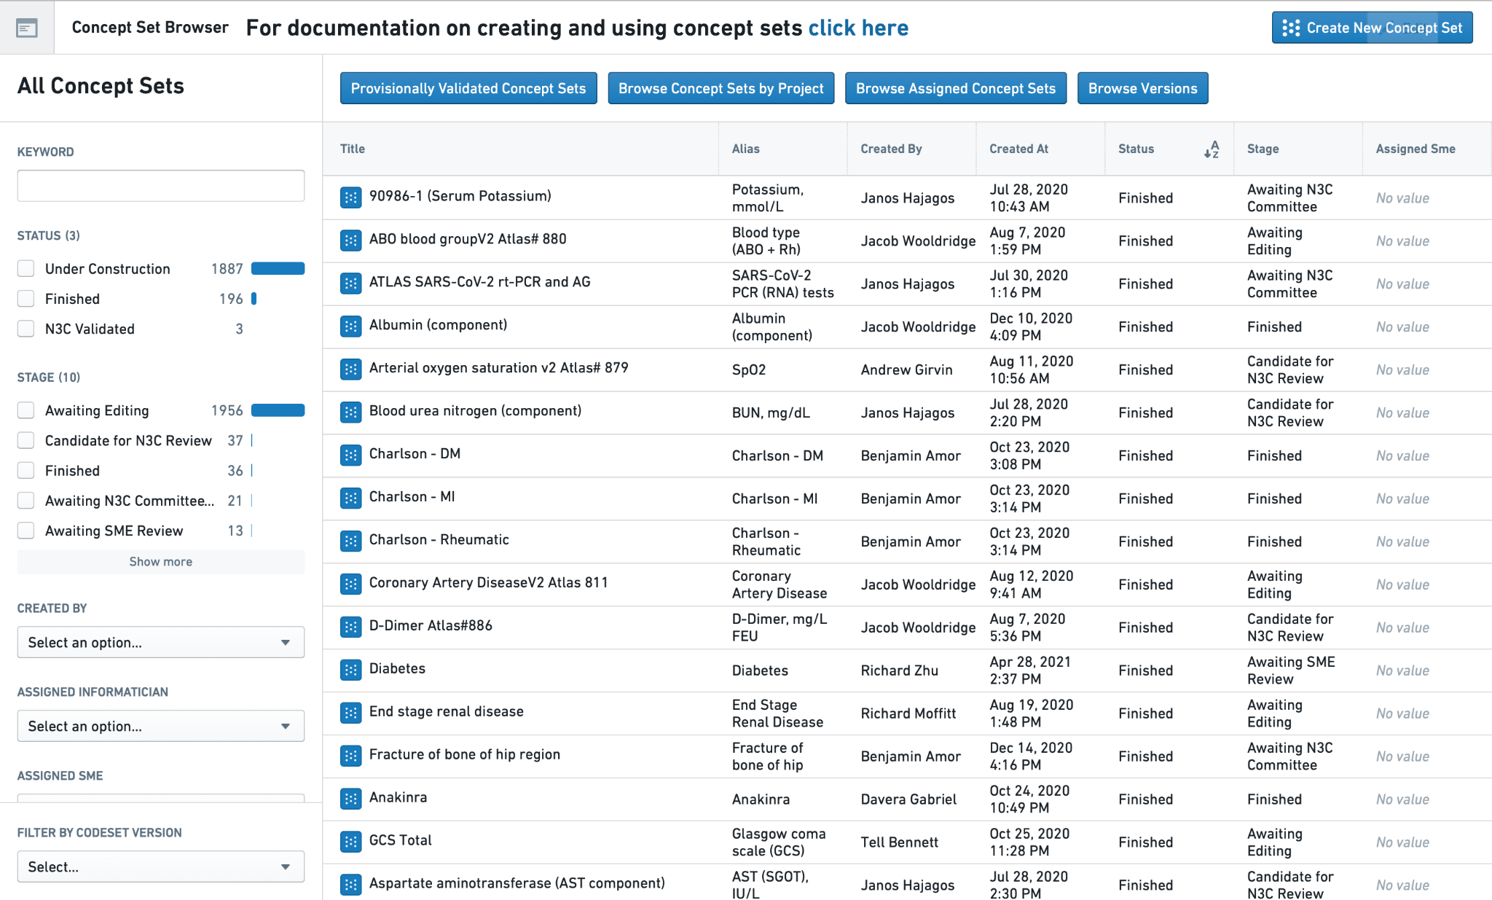
Other N3C Resources
A program of NIH’s National Center for Advancing Translational Sciences
Concept Sets:
Community-generated
“codesets” for OMOP
datasets.
New: Value Set
Authority Center
(VSAC) sets
Notes:
N3C knowledge is distributed, this orientation wouldn’t be without the help of these subject matter experts and their help
They are present (today) to answer questions: feel free to pose questions in the chat and I’ll pause yacking periodically to see if there are any quick ones, we can do more Q&A after
Shawn is me

Slide 8
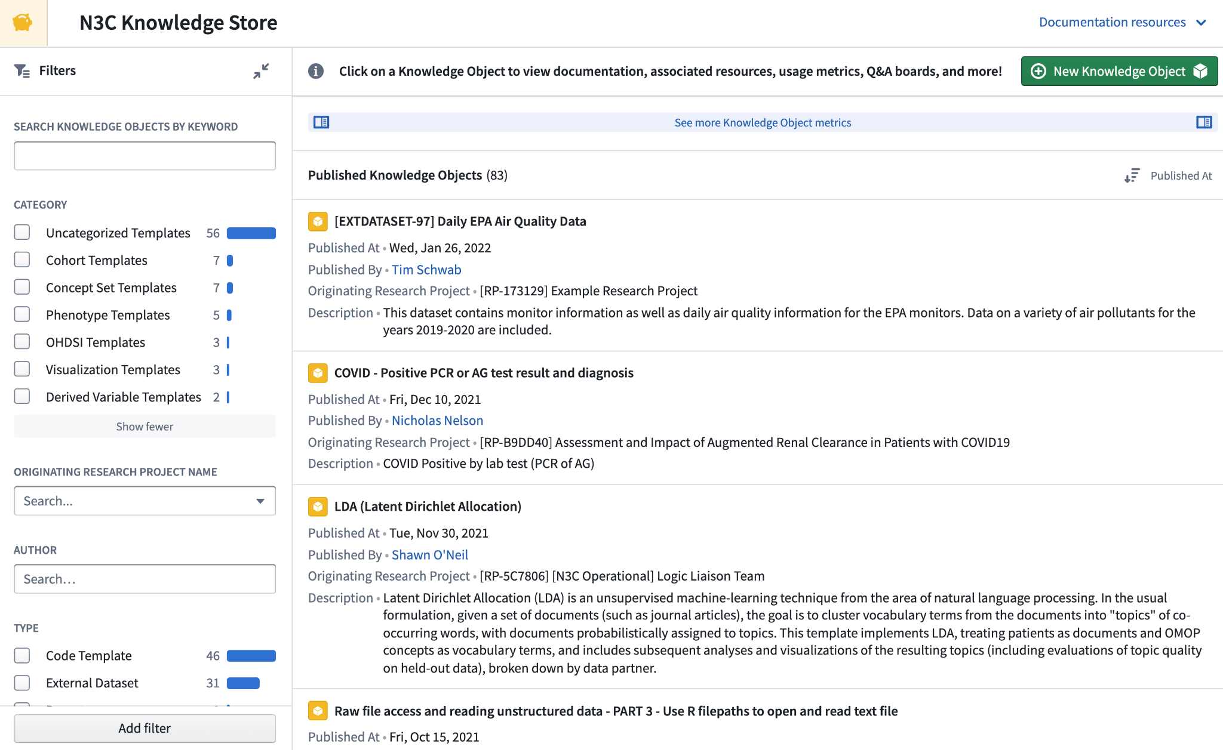
Other N3C Resources
A program of NIH’s National Center for Advancing Translational Sciences
Knowledge Store:
Community-generated
code and derived
tables for reuse
Notes:
N3C knowledge is distributed, this orientation wouldn’t be without the help of these subject matter experts and their help
They are present (today) to answer questions: feel free to pose questions in the chat and I’ll pause yacking periodically to see if there are any quick ones, we can do more Q&A after
Shawn is me

Slide 9
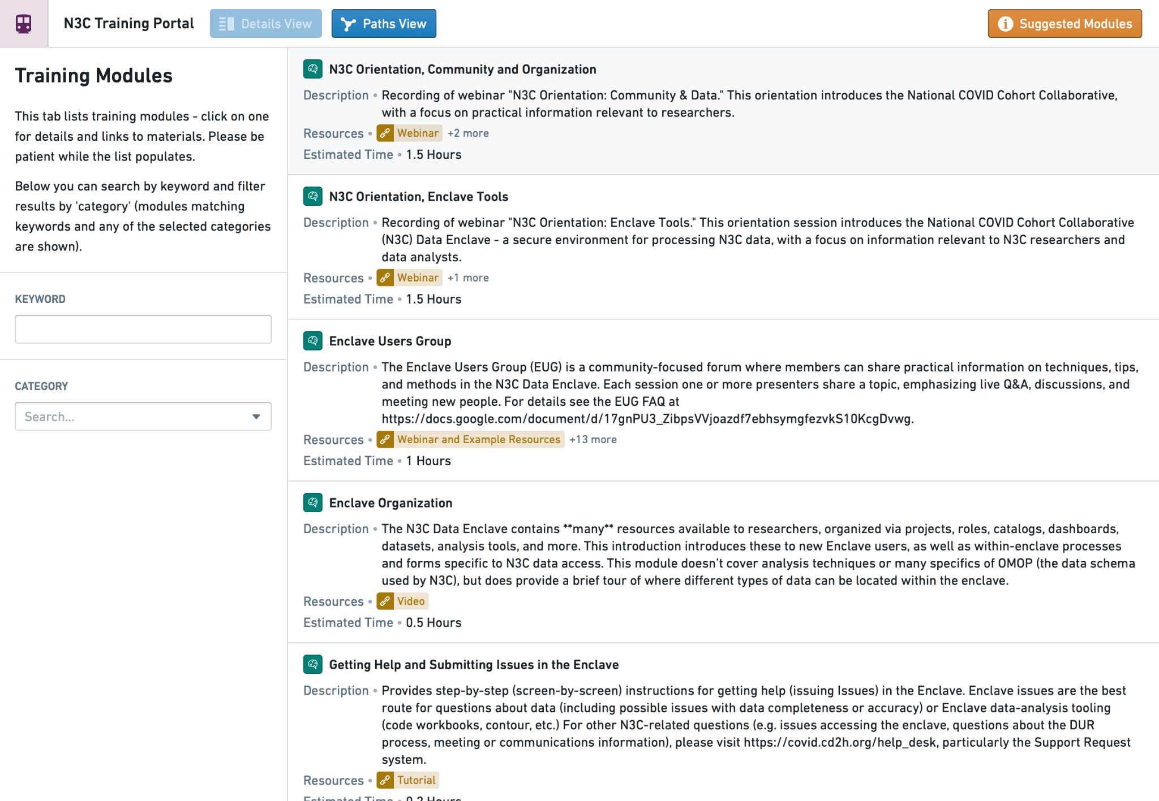
Other N3C Resources
A program of NIH’s National Center for Advancing Translational Sciences
Training Portal:
Videos and tutorials!
Notes:
N3C knowledge is distributed, this orientation wouldn’t be without the help of these subject matter experts and their help
They are present (today) to answer questions: feel free to pose questions in the chat and I’ll pause yacking periodically to see if there are any quick ones, we can do more Q&A after
Shawn is me

Slide 10
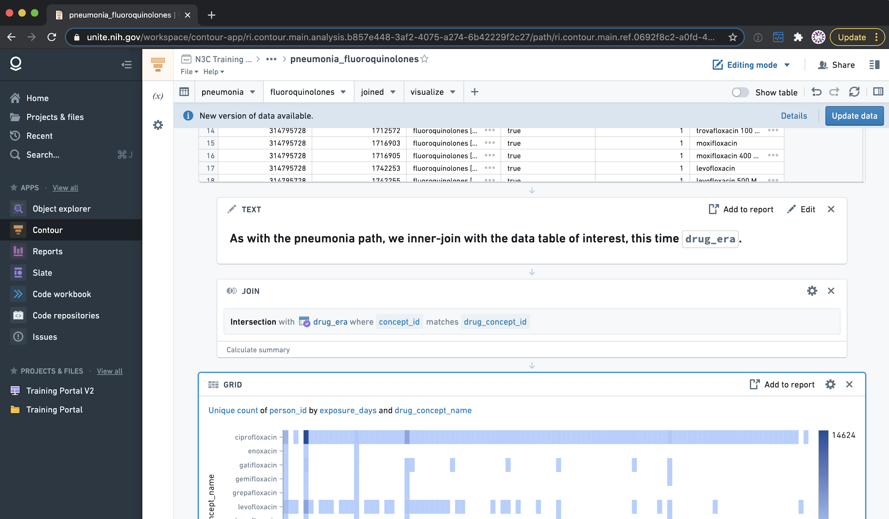
Data Analysis Tools
A program of NIH’s National Center for Advancing Translational Sciences
Contour:
GUI for data analysis
(don’t laugh, it’s
powerful!)
(notional data)
Notes:
N3C knowledge is distributed, this orientation wouldn’t be without the help of these subject matter experts and their help
They are present (today) to answer questions: feel free to pose questions in the chat and I’ll pause yacking periodically to see if there are any quick ones, we can do more Q&A after
Shawn is me

Slide 11
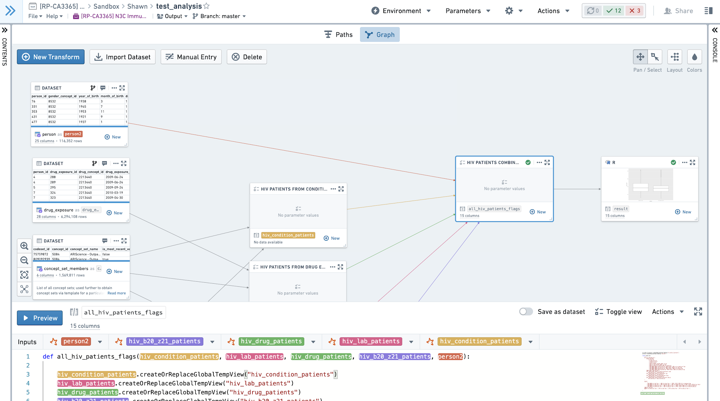


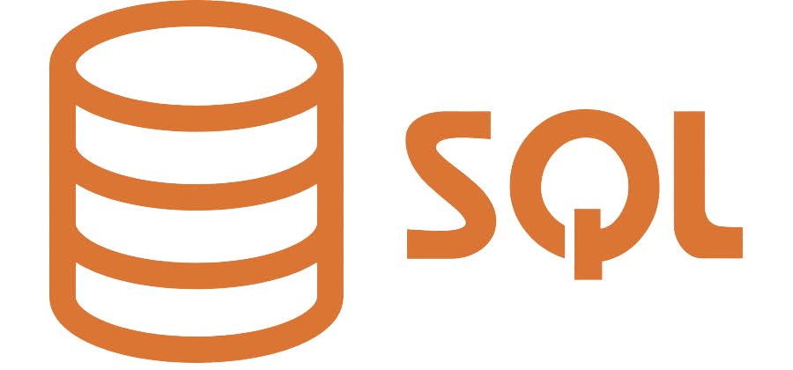

Data Analysis Tools
A program of NIH’s National Center for Advancing Translational Sciences
Code Workbooks:
Hundreds (1000s?) of
common libraries
Git-like developer tools
(notional data)
Notes:
N3C knowledge is distributed, this orientation wouldn’t be without the help of these subject matter experts and their help
They are present (today) to answer questions: feel free to pose questions in the chat and I’ll pause yacking periodically to see if there are any quick ones, we can do more Q&A after
Shawn is me

Slide 12
A program of NIH’s National Center for Advancing Translational Sciences
Ok, I’m sold.
What now?
Notes:
N3C knowledge is distributed, this orientation wouldn’t be without the help of these subject matter experts and their help
They are present (today) to answer questions: feel free to pose questions in the chat and I’ll pause yacking periodically to see if there are any quick ones, we can do more Q&A after
Shawn is me

Slide 13
Getting to the Data
A program of NIH’s National Center for Advancing Translational Sciences
Step 1: Register
https://covid.cd2h.org/registration
Get help from your CTR Investigator Navigator!
Pre-reqs: ORCiD.org ID; NIH IT Training
Step 2:
Access Enclave
Request Enclave access when registering.
Pre-reqs: Coverage by a Data Use Agreement (DUA)
Step 3:
Get Data Access
Submit a Data Use Request (DUR) form inside the enclave.
Pre-reqs: Human Subjects Research Protection Training
(for Level 2 or 3)
Letter of determination from your local IRB (for Level 3)
Notes:
N3C knowledge is distributed, this orientation wouldn’t be without the help of these subject matter experts and their help
They are present (today) to answer questions: feel free to pose questions in the chat and I’ll pause yacking periodically to see if there are any quick ones, we can do more Q&A after
Shawn is me

Slide 14

Data Usage Agreement (DUA)
A program of NIH’s National Center for Advancing Translational Sciences
Required to get platform/enclave access
Agreement to behave!
  COVID-research only
  Don’t re-identify patients or share data
  Everything in the enclave is logged
  …
Many institutions sign for their personnel
  280+ so far: https://covid.cd2h.org/duas
  Not listed? Ask your CTR Investigator Navigator!
Individuals can sign as well
  Citizen scientists - directly with NIH NCATS
https://covid.cd2h.org/account-instructions
Notes:
The best way to sign the DUA is actually to have your organization sign it on behalf of everyone there
N3C is happy to work with organizations to get this done and there are over 150 who’ve done so so far, the link lists them
For those citizen scientists who don’t have an organization to sign for them, they can sign the DUA themselves directly with NCATS. We do have a few folks who have done this

Slide 15
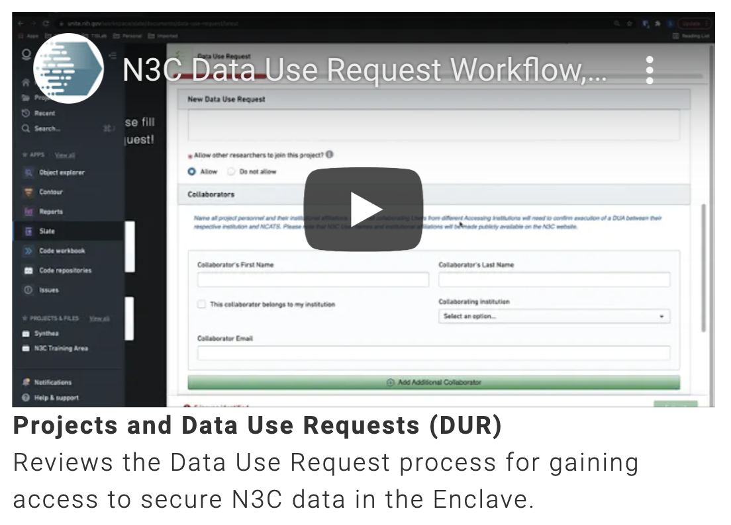
Submitting and Managing DURs
A program of NIH’s National Center for Advancing Translational Sciences
DURs & projects have a “lingo”
Project Lead: Submits first DUR
for a project (sets title, abstract, data level)
Collaborator: Signs “onto” an existing DUR
(can’t change title, abstract, data level)
Data Access Committee (DAC): Reviews
DUR submissions for leads and collaborators
Leads can manage access to collaborator requests
(Via project settings)
https://covid.cd2h.org/training
And your CTR Investigator Navigator!
Notes:
The best way to sign the DUA is actually to have your organization sign it on behalf of everyone there
N3C is happy to work with organizations to get this done and there are over 150 who’ve done so so far, the link lists them
For those citizen scientists who don’t have an organization to sign for them, they can sign the DUA themselves directly with NCATS. We do have a few folks who have done this

Slide 16
Other Rules of the Road
A program of NIH’s National Center for Advancing Translational Sciences
User Code of Conduct
  COVID-research only
  Follow laws and regulations
  Don’t re-identify people, institutions, or populations
  No screenshots, video recording, or copy/paste of data or results
    Video calls are OK if all on the call are approved & have access themselves
  Report data access incidents within 2 business days
Community Guiding Principles
  Partnership, Inclusivity, Transparency, Reciprocity, Accountability, Security
  Also guidelines on Ethics, Diversity and Inclusion, and Resolving Issues through Community Arbitration
https://covid.cd2h.org/policy

Slide 17
Other Rules of the Road
A program of NIH’s National Center for Advancing Translational Sciences
Publications & Exporting Results
  Got a paper to submit? Poster or abstract accepted? Run it by the Publication Committee!
  All summary tables and figures must be submitted (via form in the enclave) for review before export
  Summary: no “cell sizes” of 1 through 19 (0 and 20+ are OK)
  Details at https://covid.cd2h.org/publication-review

Slide 18

N3C Community
A program of NIH’s National Center for Advancing Translational Sciences
N3C is more than data, it’s a community!
Registered Users: 2700+
Enclave Users: 1800+
Research Projects: 240+
Institutions with Data Usage Agreements: 220+
Data Transfer Agreement Signatories: 89+
Slack channels: 30+ https://cd2h.slack.com
Google groups: 30+
Regular meetings: 20+ https://covid.cd2h.org/n3c-calendar
and many more!
Notes:
And in case you didn’t have enough zoom meetings, we’ve got lots of those too

Slide 19
N3C ‘Map’ (Unofficial, Incomplete)
A program of NIH’s National Center for Advancing Translational Sciences
Data Partnership & Governance
Publications Committee
Clinical DTs
Project Management / Admin Team
DT: Diabetes & Obesity
RP: Diabetes Risk Factors
Synthetic Data
Synthetic Validation
DT: Immunosuppressed / Immunocompromised
RP: COVID + HIV
Collaborative Analytics
RP: Heart Disease & C19
RP: Autoimmune Skin Disorders
Cross-Cutting DTs
Phenotype & Data Acquisition
Domain Teams
DT: Machine Learning
RP: …
Data Ingestion & Harmonization
Supports
DT: Education & Training
RP: …
Data Liaisons
https://covid.cd2h.org/domain-teams

Slide 20

Next Steps
A program of NIH’s National Center for Advancing Translational Sciences
Check out the resources discussed today
Register (if you haven’t already)
  https://covid.cd2h.org/for-researchers
Visit the N3C website, especially Domain Teams
  https://covid.cd2h.org/domain-teams
Access the Enclave and browse around, especially training resources
Come back for Orientation Session B, where we’ll introduce analysis techniques and tools for working with N3C data effectively!

