Slide 1













IDeA-CTR N3C Investigator Engagement Event:
Jumpstarting Access to Clinical Data
for COVID-19 Research
Thursday, February 17, 2022 | 2:00-5:00 PM EST
CTR N3C Studies
Association of Vitamin D Prescribing and Clinical Outcomes in Adults Hospitalized with COVID-19
Kimberly Murray, MPP
Senior Research Analyst
Maine Medical Center Research Institute
U54GM104942-06S4

Slide 2
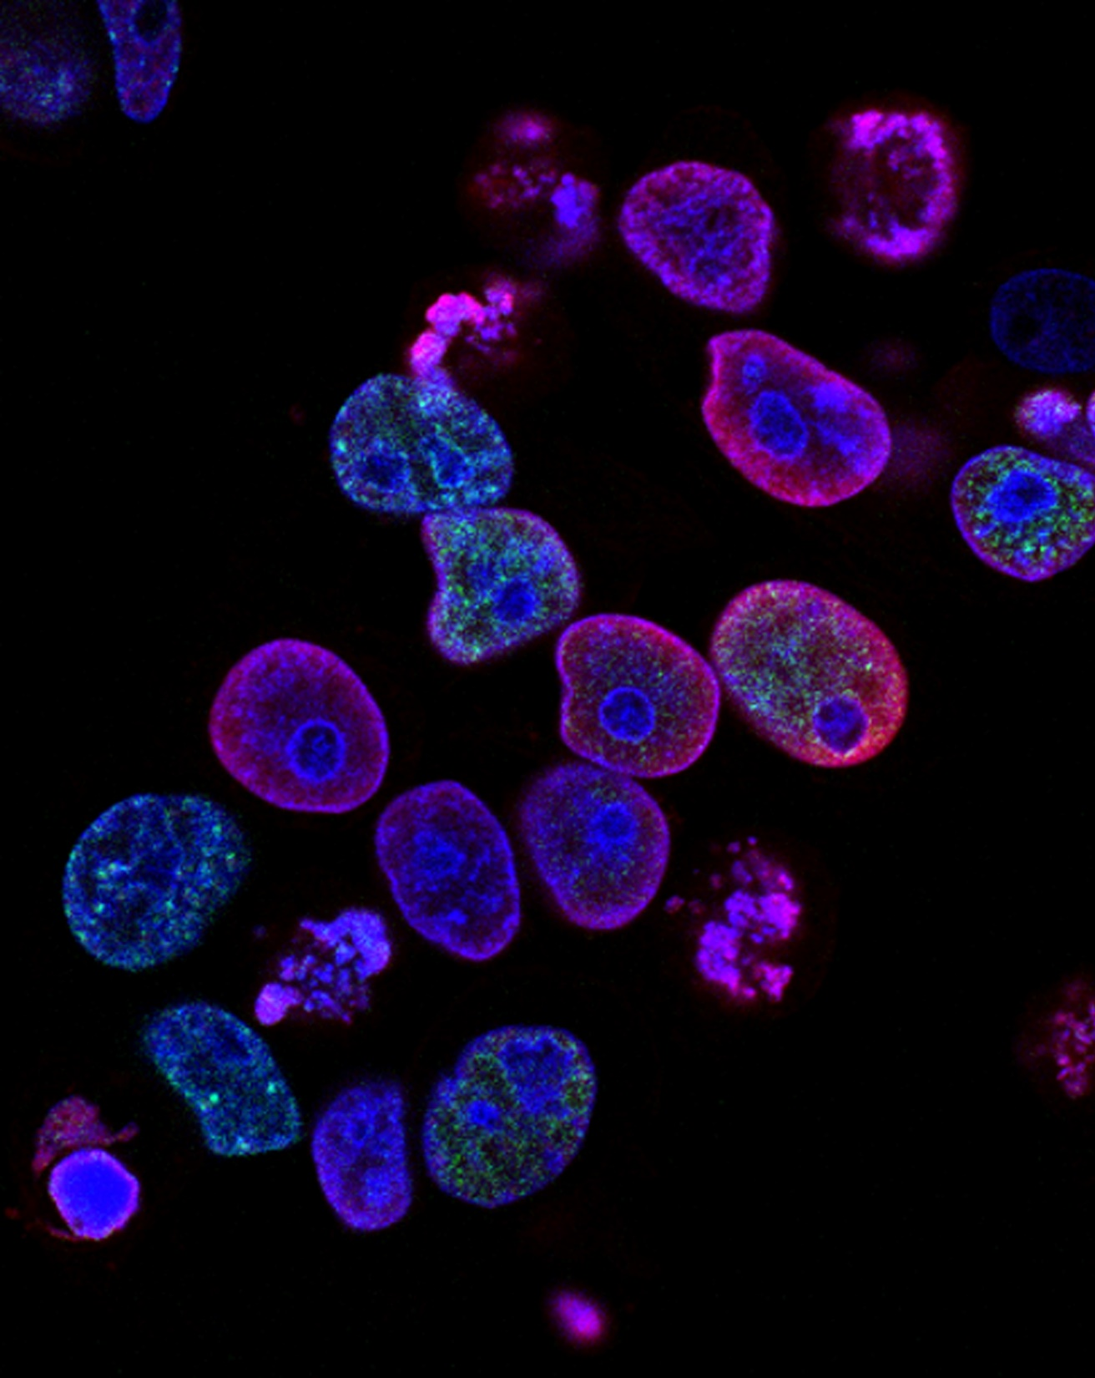
Association of Vitamin D Prescribing and Clinical Outcomes in Adults Hospitalized with COVID-19
ISCORE
Kim Murray, MPP
Kathleen M. Fairfield, MD, DrPH
Jerrod Anzalone, MS
Will Beasley, PhD
Maryam Khodaverdi, MS
Sally Hodder, MD
Jeremy Harper, MS
Susan Santangelo, ScD
Clifford J. Rosen, MD
IDeA States Consortium for Clinical Research
February 17, 2022

Slide 3

Background
Objectives
To examine the relationship between Vitamin D treatment on three COVID-19 outcomes:
    Death or referral to hospice
    Length of stay greater than 5 days
    Mechanical Ventilation or ECMO
Methods
158,900 adult patients hospitalized for COVID-19
    Jan 1, 2020 – July 31, 2021
Vitamin D prescribing was identified using all available names for vitamin D and its derivatives.
Patient characteristics were examined in relationship to vitamin D receipt, including age, sex, race, BMI, and Charlson Comorbidity Index, and rural or urban residence (using RUCA codes)
Vitamin D is known to have complex effects on immunity including:
  activating innate immunity in an autocrine manner
  reduces the overactive immune response, which may be relevant in the cytokine storm observed in severe infections
  Vitamin D deficiency is associated with auto-immunity
Smaller studies examining the relationship between clinical outcomes from COVID-19 and vitamin D have produced variable results, although larger clinical trials are pending
ISCORE
IDeA States Consortium for Clinical Research

Slide 4
Results
A
B
C
D
Patient Outcomes by Vitamin D Treatment
OUTCOME | All Patients | % Prescribed Vitamin D
Death/Referral to hospice | 16903 (11%) | 3666 (21%)
Length of stay > 5 days | 75784 (48%) | 17386 (23%)
Mechanical Ventilation/ECMO | 20428 (13%) | 4900 (24%)
ISCORE
IDeA States Consortium for Clinical Research

Slide 5
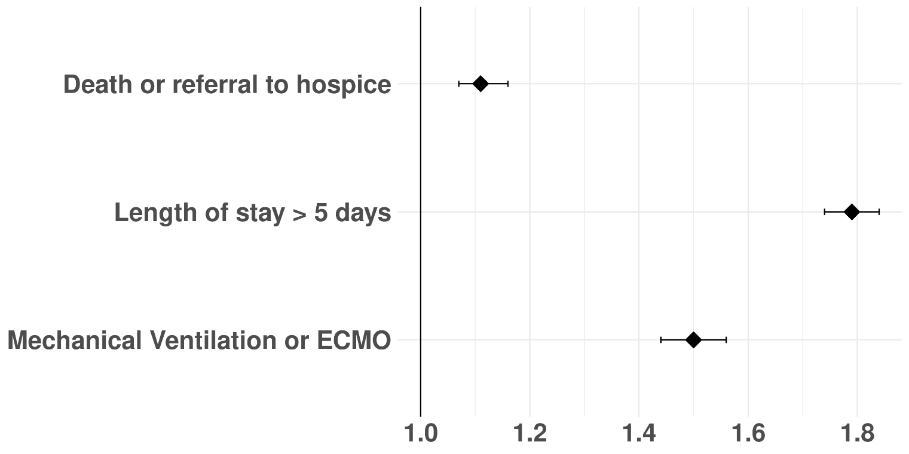
Odds of Study Outcomes
According to Treatment of Vitamin D: Full Cohort
Results from Multivariable logistic regression models (N=158,900)
Covariates:
Age
Sex
Race
data submitter
time period (year/quarter of diagnosis)
BMI
CCI
vitamin D treatment,
RUCA code (urban/rural residence)
AOR (95% CI)
1.11 (1.07-1.16)
1.79 (1.74-1.84)
1.50 (1.44-1.56)
Adjusted Odds Ratios (95% CI)
ISCORE
IDeA States Consortium for Clinical Research

Slide 6
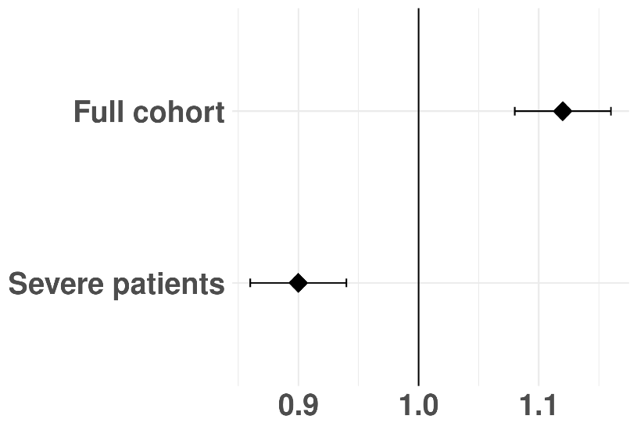
Odds of Death or Referral to Hospice
According to Treatment of Vitamin D: Sub-Analysis
Inclusion Criteria for Severe Patients: (N=81,446)
Death or referral to hospice (N=16,908)
Length of stay > 5 days (N=75,784)
Mechanical ventilation or ECMO (N=20,428)
AOR (95% CI)
1.11 (1.07-1.16)
0.90 (0.86-0.94)
Adjusted Odds Ratios (95% CI)
ISCORE
IDeA States Consortium for Clinical Research

Slide 7
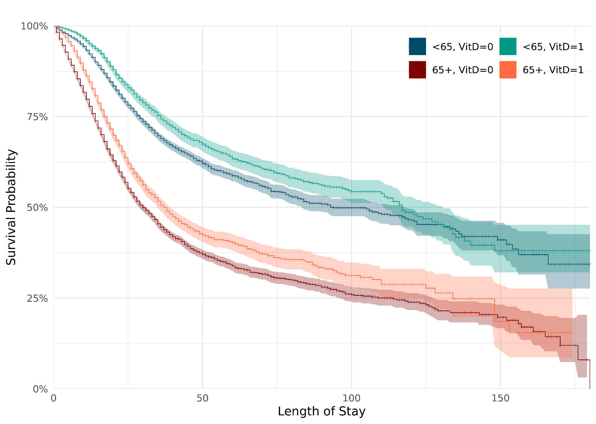
Kaplan-Meier Curves for Patients with
Severe Outcomes by Age and Vitamin D Treatment
ISCORE
IDeA States Consortium for Clinical Research

Slide 8
Conclusions
Vitamin D was prescribed more frequently to patients who were older or had more comorbidities, suggesting that patients who were doing poorly were more likely to be treated with Vitamin D.
We observed an unexpected positive relationship between vitamin D treatment and adverse clinical outcomes including death or referral to hospice, length of stay more than 5 days, and mechanical ventilation or ECMO.
But among those patients with severe disease, there was an inverse relationship of Vitamin D treatment and death or referral to hospice.
ISCORE
IDeA States Consortium for Clinical Research

Slide 9
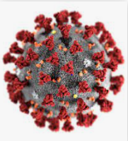
Thank you !
ISCORE
IDeA States Consortium for Clinical Research

