Slide 1













IDeA-CTR N3C Investigator Engagement Event:
Jumpstarting Access to Clinical Data
for COVID-19 Research
Thursday, February 17, 2022 | 2:00-5:00 PM EST
Closing Remarks
Navigating N3C at Your IDeA-CTR Site
Sharon Patrick, MS, MPA, CPCS
West Virginia Clinical and Translational Science Institute
Elizabeth S. Chen, PhD
Advance Rhode Island Clinical & Translational Research
U54GM104942-06S4

Slide 2
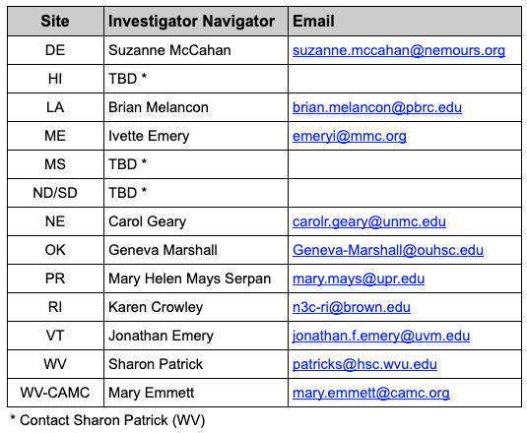
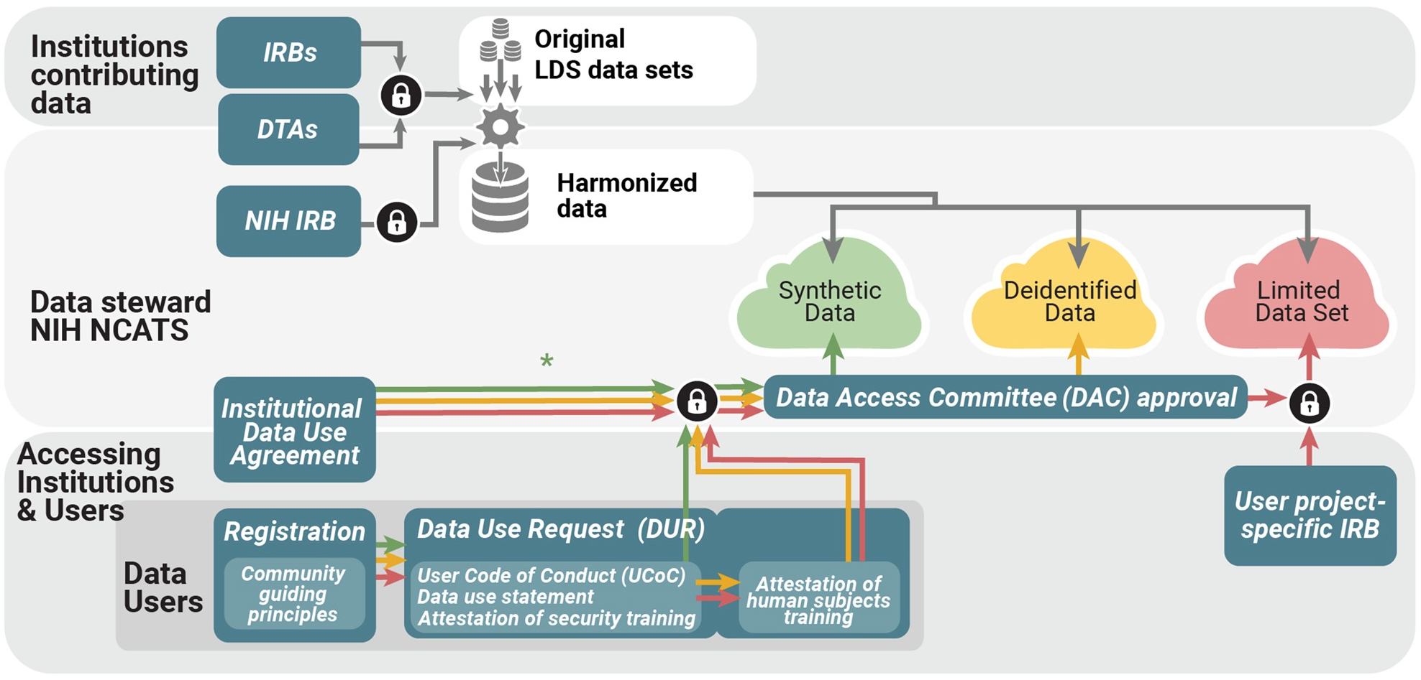
CTR N3C Navigators
Guide CTR researchers in:
Creating N3C Enclave accounts
Joining Domain Teams
Joining projects in progress
Formulating and submitting Data Use Requests (DURs) for new projects
Submitting IRB protocols
Understanding and following standard research protocols for analysis of electronic health data (with Analyst)
Requesting downloads or research artifacts
Preparing manuscripts that include materials to support transparency and reproducibility (with Analyst)
Submit manuscripts to committees for review (with Analyst)
…
Haendel MA, Chute CG, Bennett TD, et al. The National COVID Cohort Collaborative (N3C): Rationale, design, infrastructure, and deployment. J Am Med Inform Assoc. 2021 Mar 1;28(3):427-443. doi: 10.1093/jamia/ocaa196. PMID: 32805036; PMCID: PMC7454687.

Slide 3
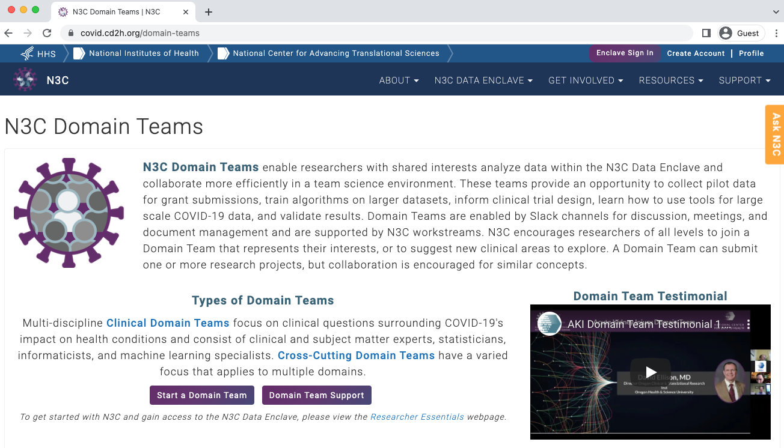

CTR N3C Domain Teams
CTR Led or Co-Led
Cardiovascular Diseases
Cardiothoracic and Vascular Surgery
Education and Training
GIS and Spatial Epidemiology
Immunocompromised and Suppressed
Lifespan Disabilities
Pediatric
Perioperative
Rural Health
https://covid.cd2h.org/domain-teams

Slide 4
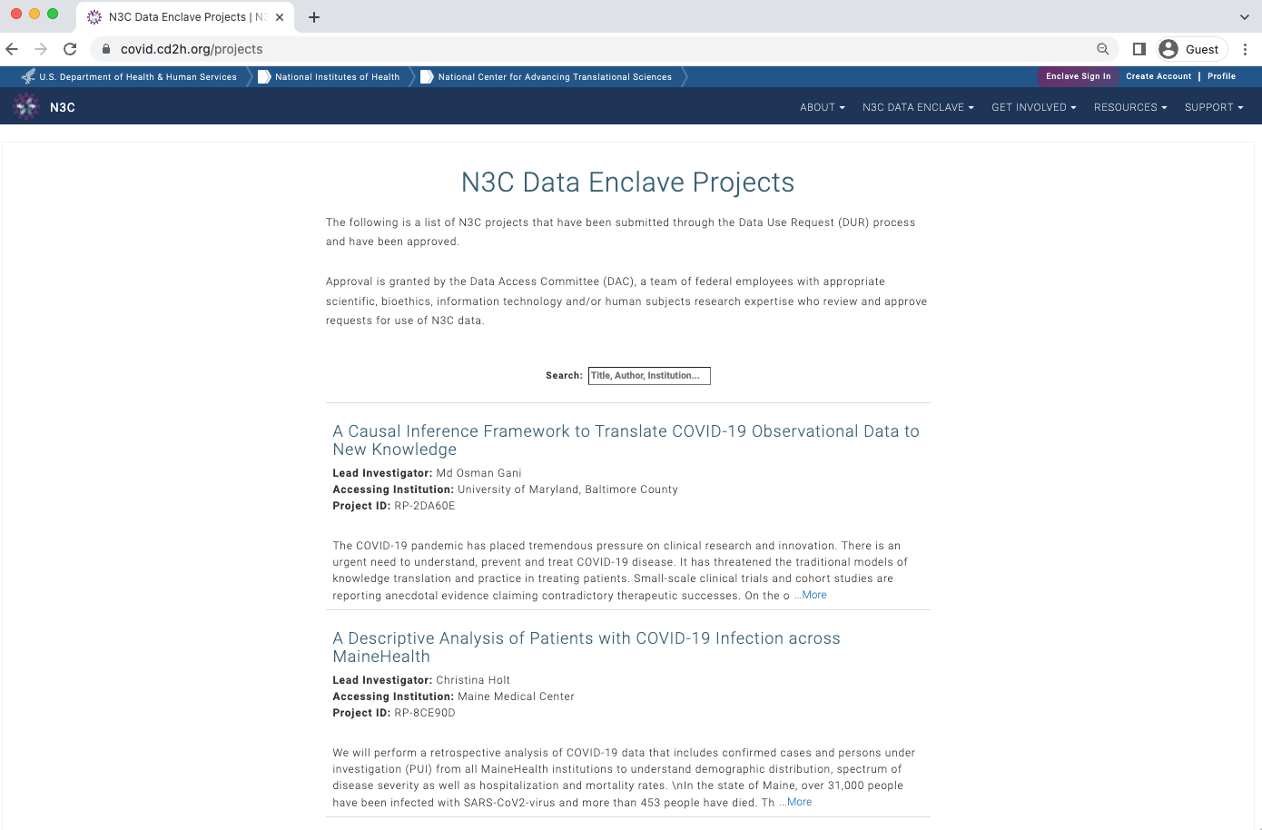
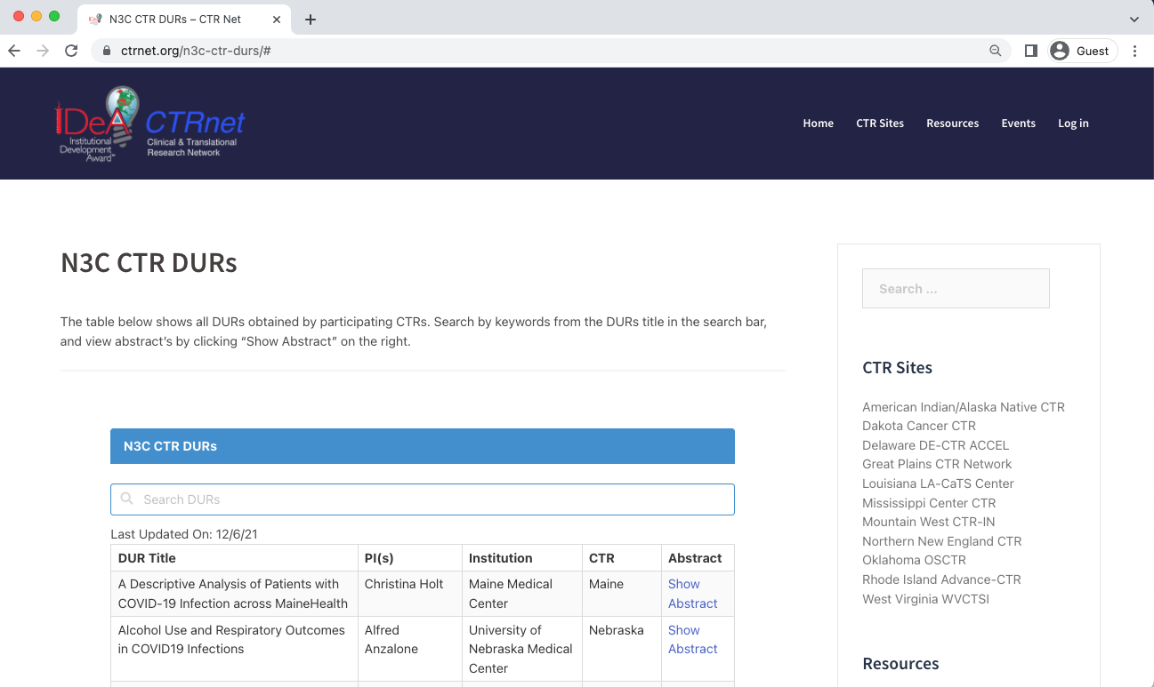
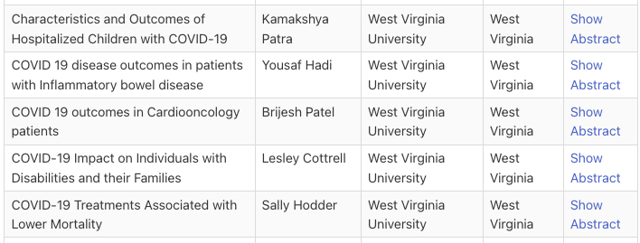
CTR N3C DURs (Projects)
https://covid.cd2h.org/projects
https://www.ctrnet.org/n3c-ctr-durs/

Slide 5
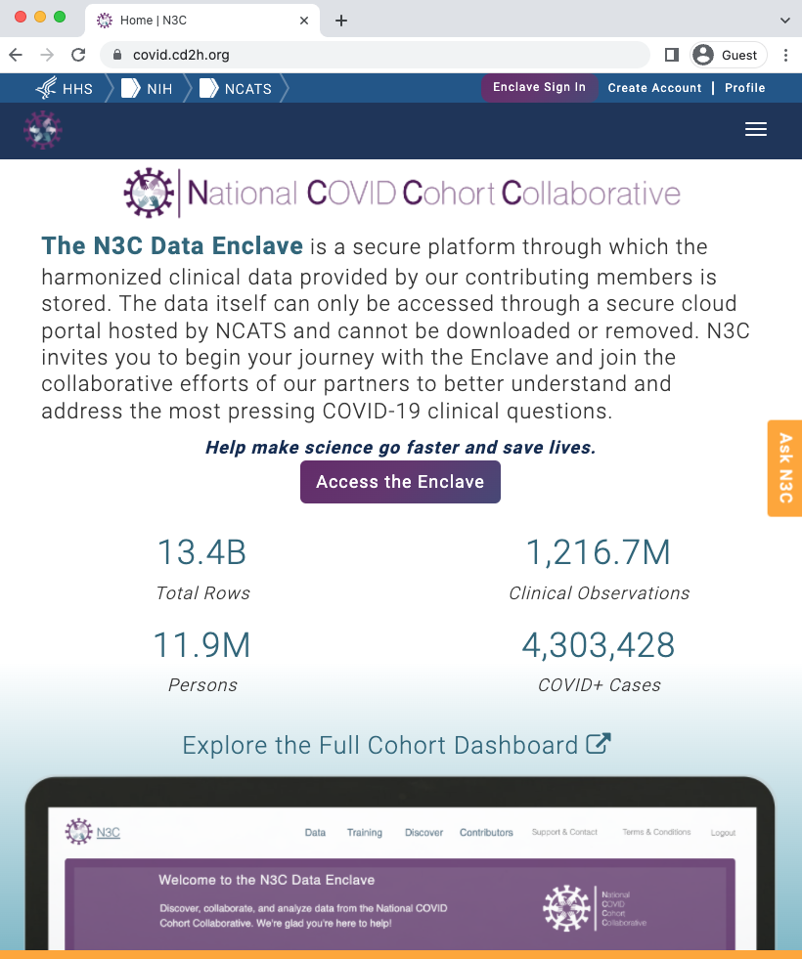
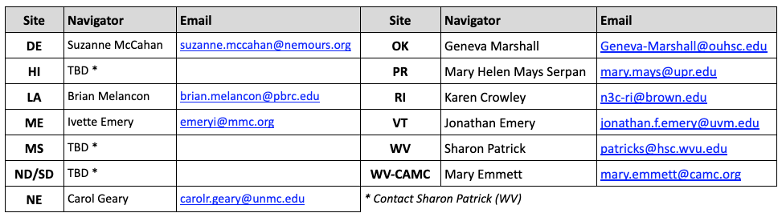
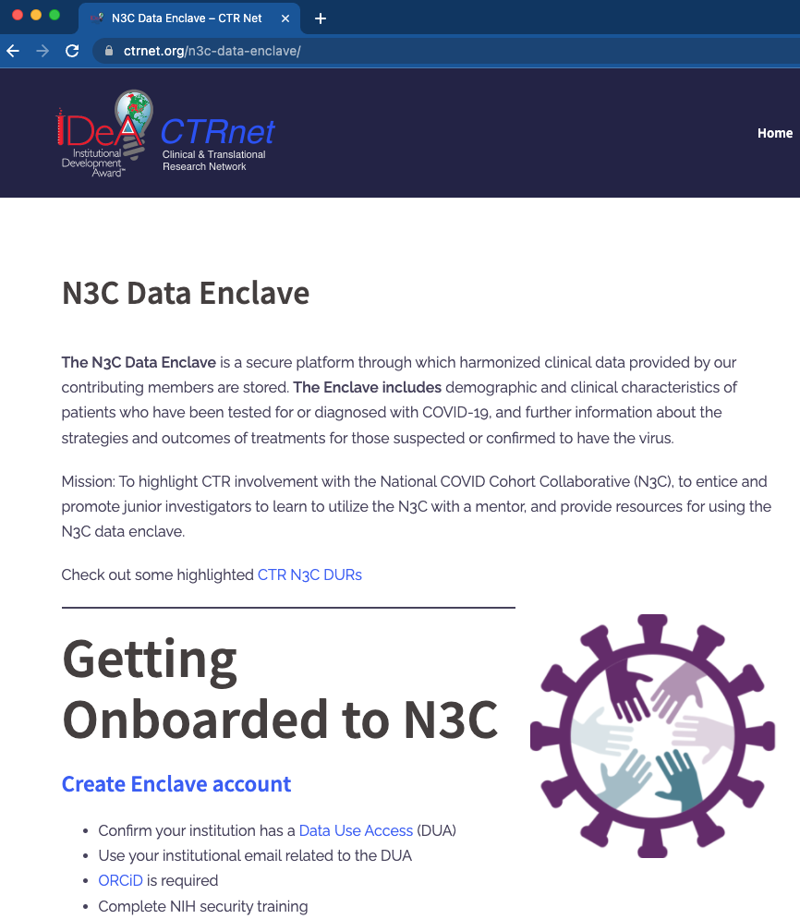
IDeA-CTR N3C Investigator Engagement Event:
Jumpstarting Access to Clinical Data
for COVID-19 Research
Thursday, February 17, 2022 | 2:00-5:00 PM EST
Thanks and Acknowledgments
IDeA-CTR N3C Investigator Navigators
https://covid.cd2h.org/
IDeA-CTR N3C Education Committee | Amber Abel (WV-CTR) Jerrod Anzalone, MS (GP-CTR) Will Beasley, PhD (OK-CTR) Liz Chen, PhD (RI-CTR; Chair) Karen Crowley, MD, PhD (RI-CTR) | Ivette Emery, PhD (NNE-CTR) Mary Helen Mays, PhD, MSHI, MBA, MPH, RD (PR-CTR) Kim Murray, MPP (NNE-CTR) Sharon Patrick, MS, MPA, CPCS (WV-CTR)
https://www.ctrnet.org/n3c-data-enclave/
U54GM104942-06S4

